Slide 1


Slide 2


Slide 3
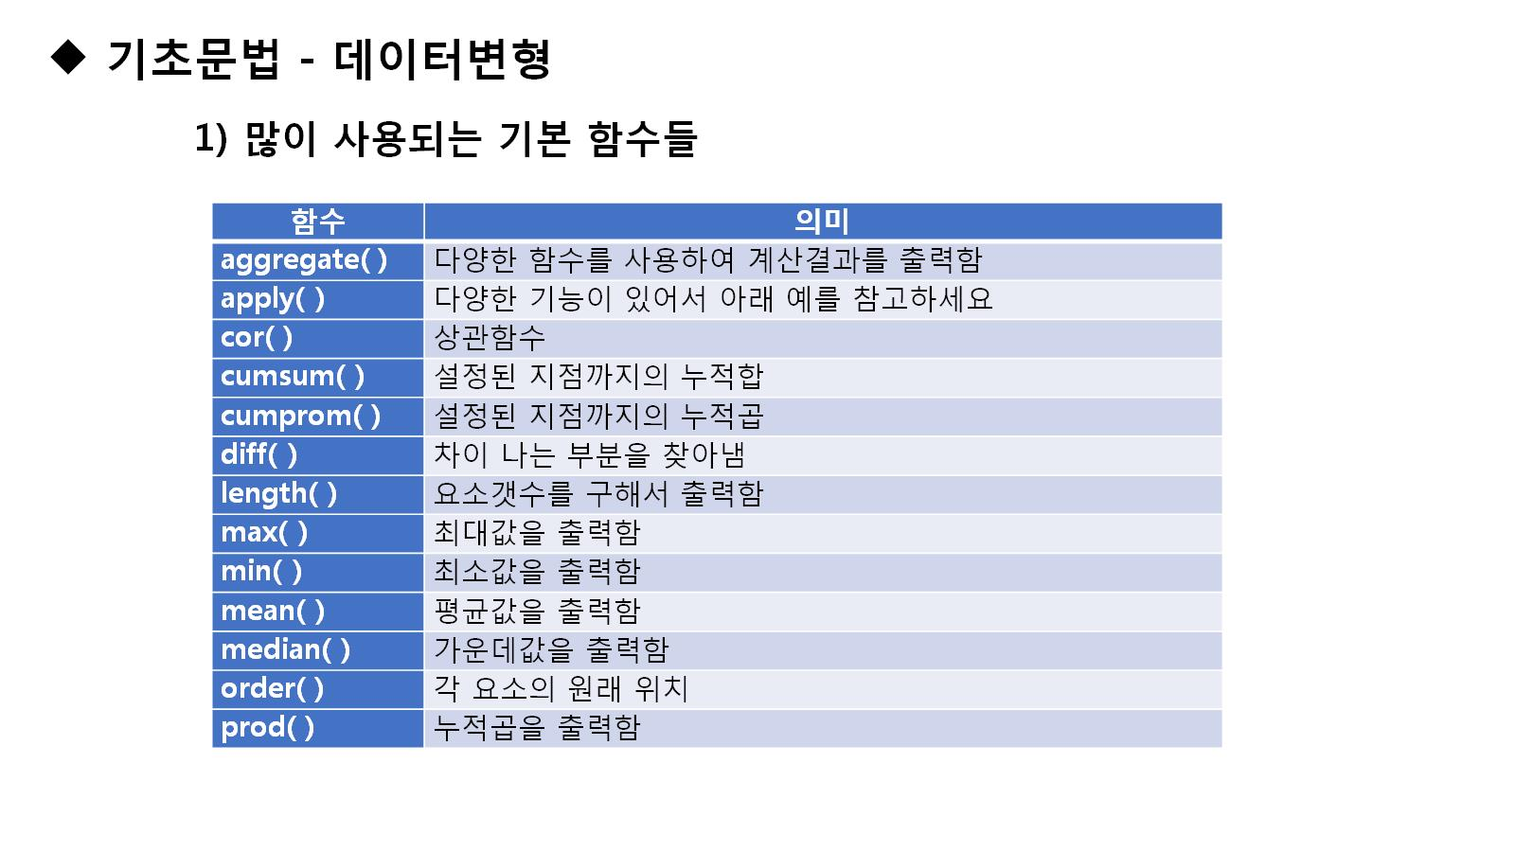

Slide 4
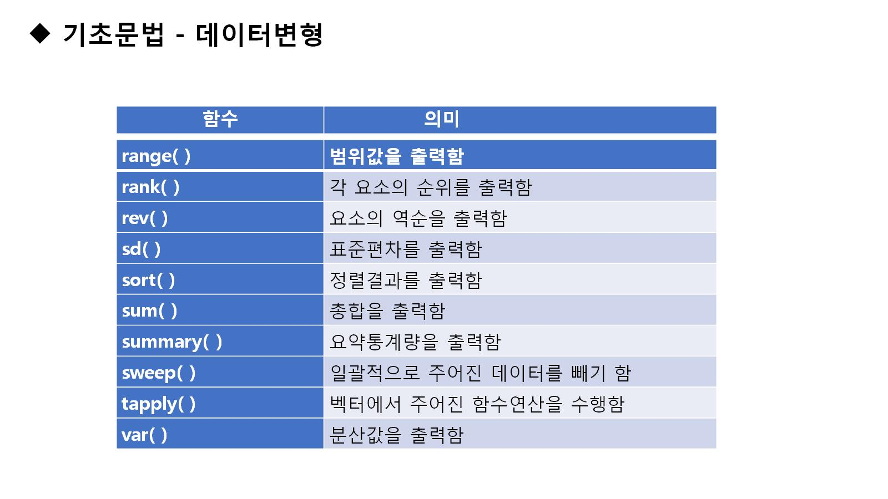

Slide 5
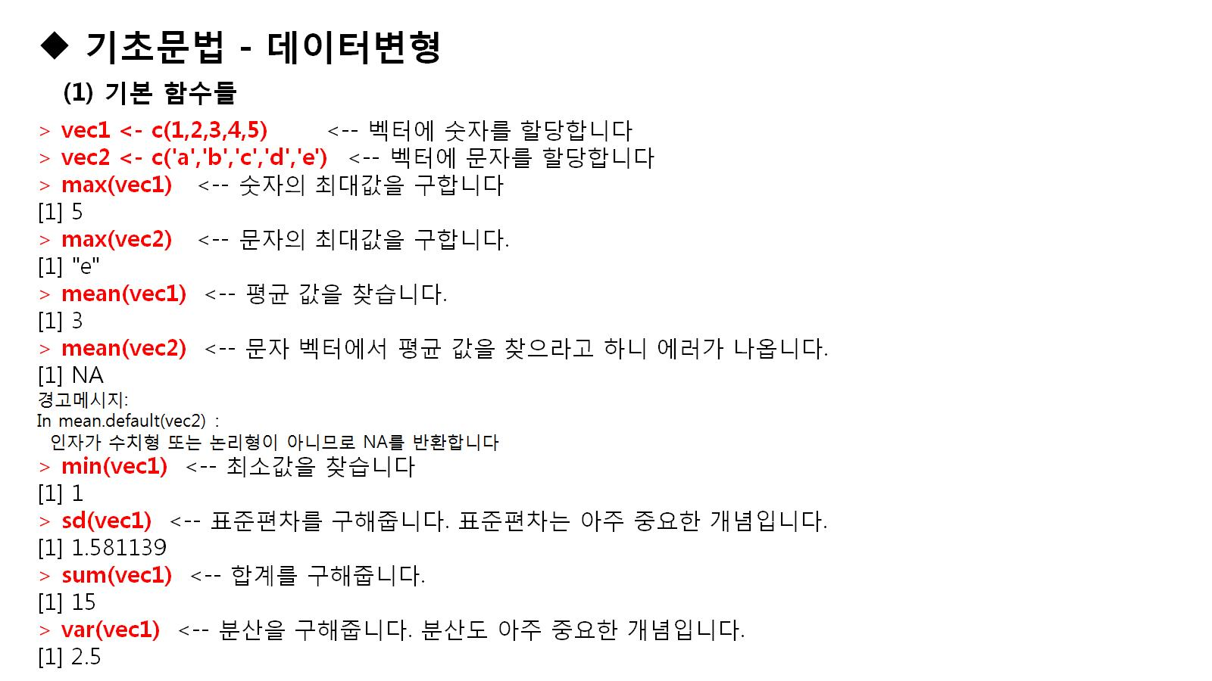

Slide 6
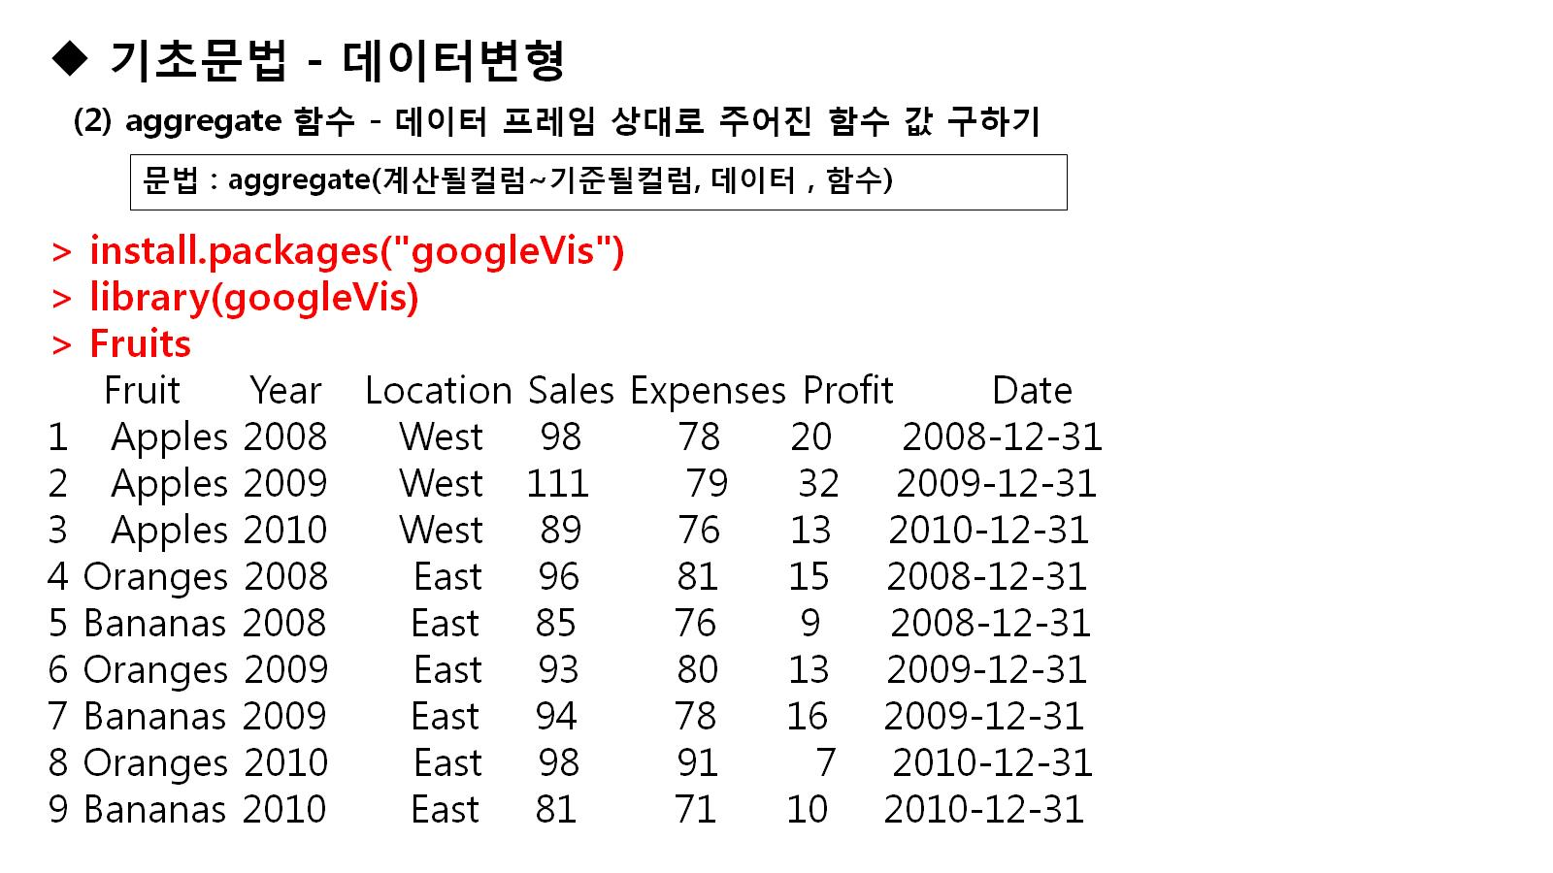

Slide 7
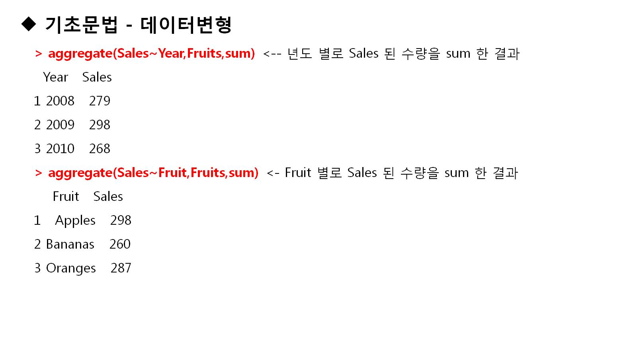

Slide 8
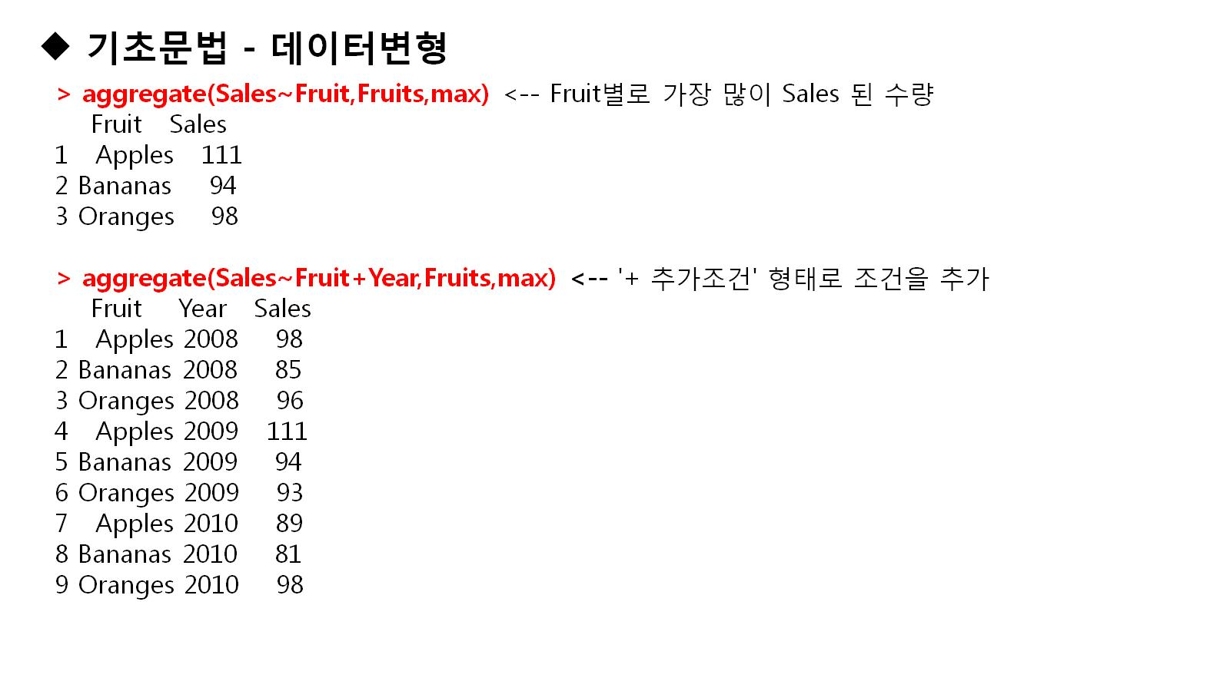

Slide 9
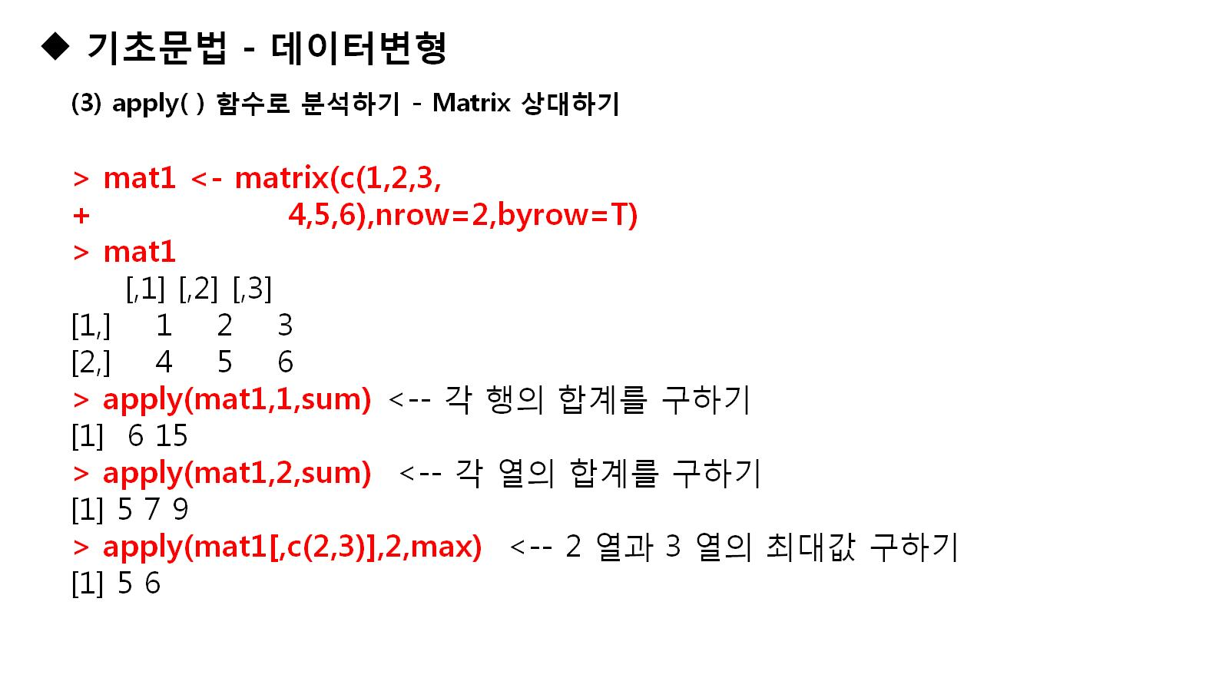

Slide 10
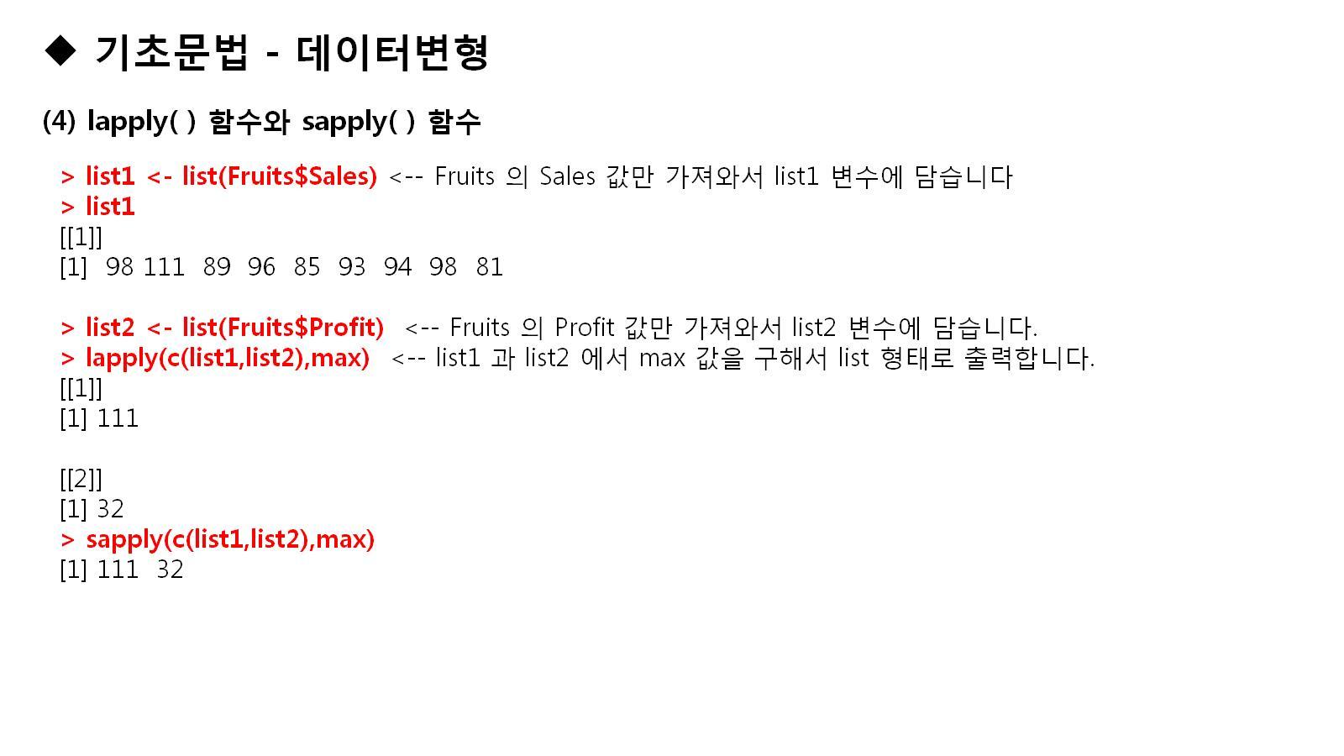

Slide 11
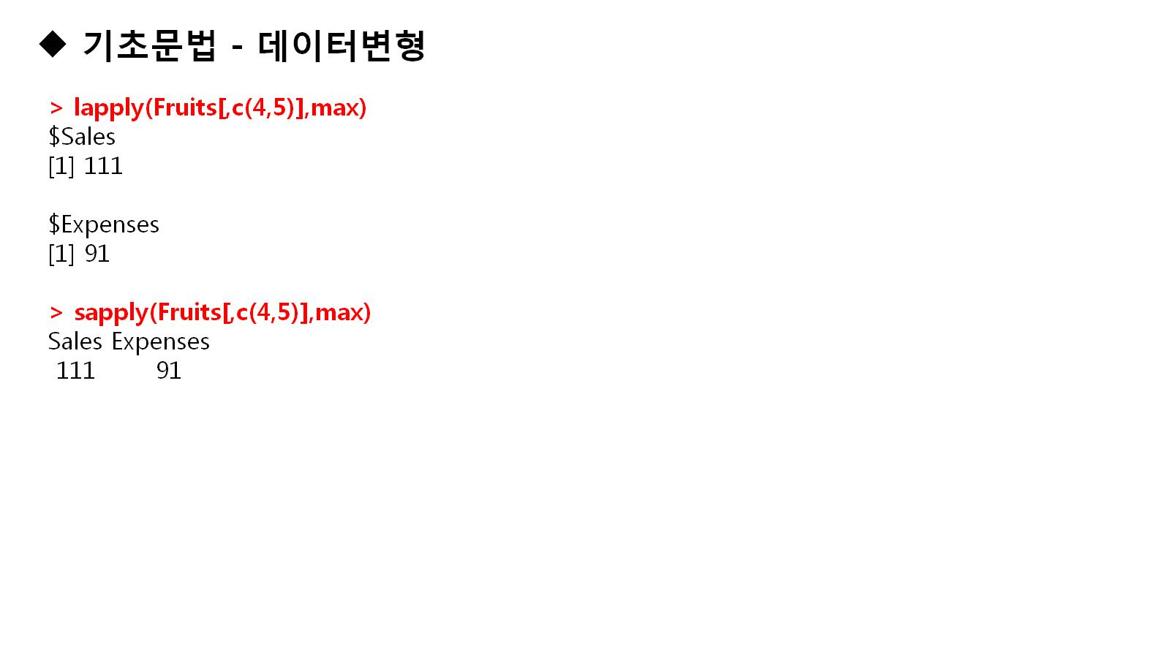

Slide 12
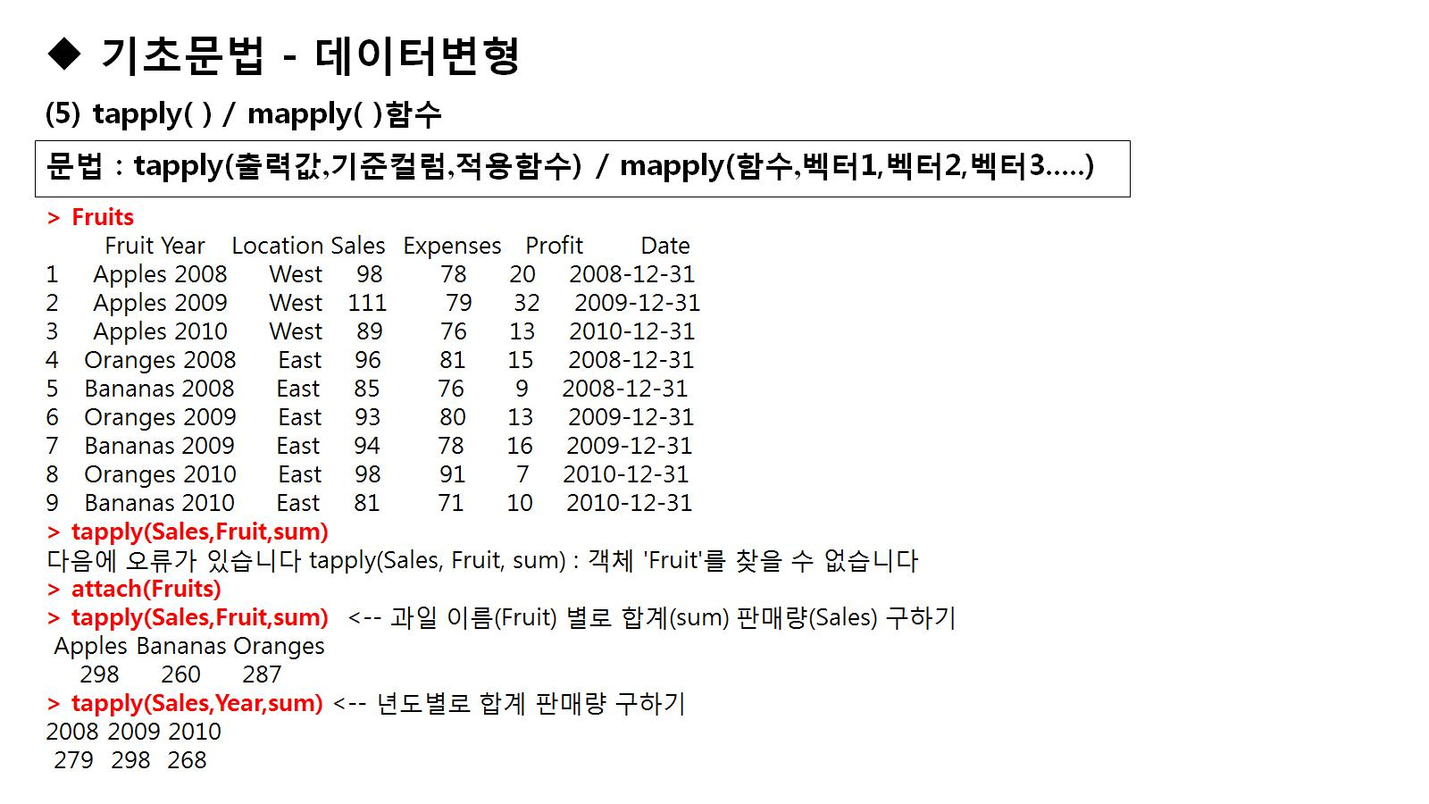

Slide 13
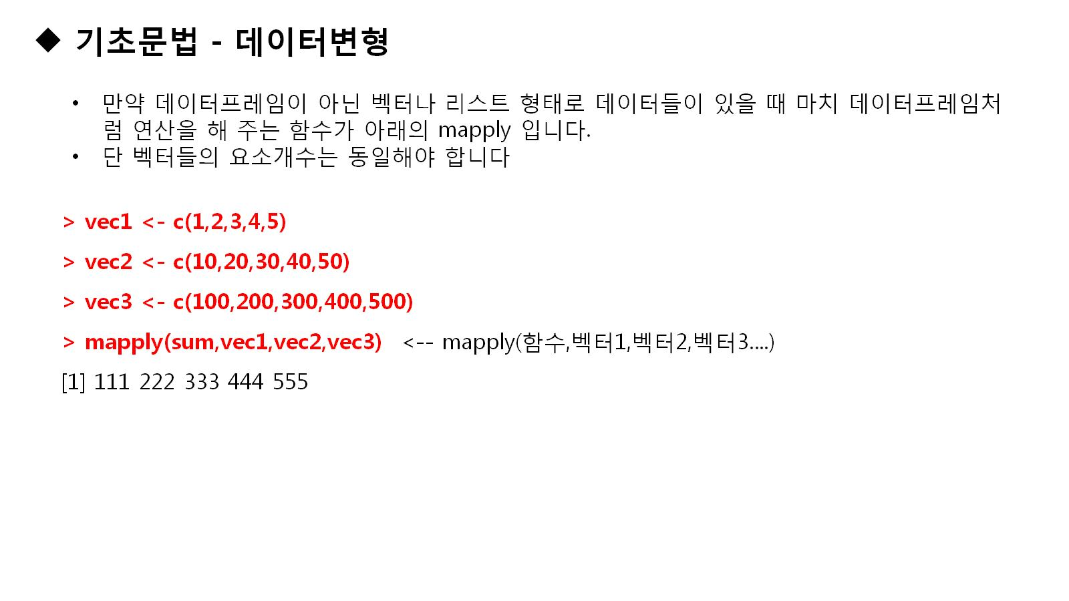
Notes:
install.packages("googleVis")
Fruits
aggregate(Sales~Year,Fruits,sum)
aggregate(Sales~Fruit,Fruits,sum)
aggregate(Sales~Fruit,Fruits,max)
aggregate(Sales~Fruit+Year,Fruits,max)
mat1<-matrix(c(1,2,3,4,5,6),nrow=2,byrow=T)
mat1
apply(mat1,1,sum)
apply(mat1,2,sum)
apply(mat1[,c(2,3)],2,max)
list1<-list(Fruits$Sales)
list1
list2<-list(Fruits$Profit)
lapply(c(list1,list2),max)
sapply(c(list1,list2),max)
lapply(Fruits[,c(4,5)],max)
sapply(Fruits[,c(4,5)],max)
Fruits
tapply(Sales,Fruit,sum)
attach(Fruits)
tapply(Sales,Fruit,sum)
tapply(Sales,Year,sum)
vec1<-c(1,2,3,4,5)
vec2<-c(10,20,30,40,50)
vec3<-c(100,200,300,400,500)
mapply(sum,vec1,vec2,vec3)

Slide 14
install.packages("googleVis")
Fruits
aggregate(Sales~Year,Fruits,sum)
aggregate(Sales~Fruit,Fruits,sum)
aggregate(Sales~Fruit,Fruits,max)
aggregate(Sales~Fruit+Year,Fruits,max)
mat1<-matrix(c(1,2,3,4,5,6),nrow=2,byrow=T)
mat1
apply(mat1,1,sum)
apply(mat1,2,sum)
apply(mat1[,c(2,3)],2,max)
list1<-list(Fruits$Sales)
list1
list2<-list(Fruits$Profit)
lapply(c(list1,list2),max)
sapply(c(list1,list2),max)
lapply(Fruits[,c(4,5)],max)
sapply(Fruits[,c(4,5)],max)
Fruits
tapply(Sales,Fruit,sum)
attach(Fruits)
tapply(Sales,Fruit,sum)
tapply(Sales,Year,sum)
vec1<-c(1,2,3,4,5)
vec2<-c(10,20,30,40,50)
vec3<-c(100,200,300,400,500)
mapply(sum,vec1,vec2,vec3)

Slide 15
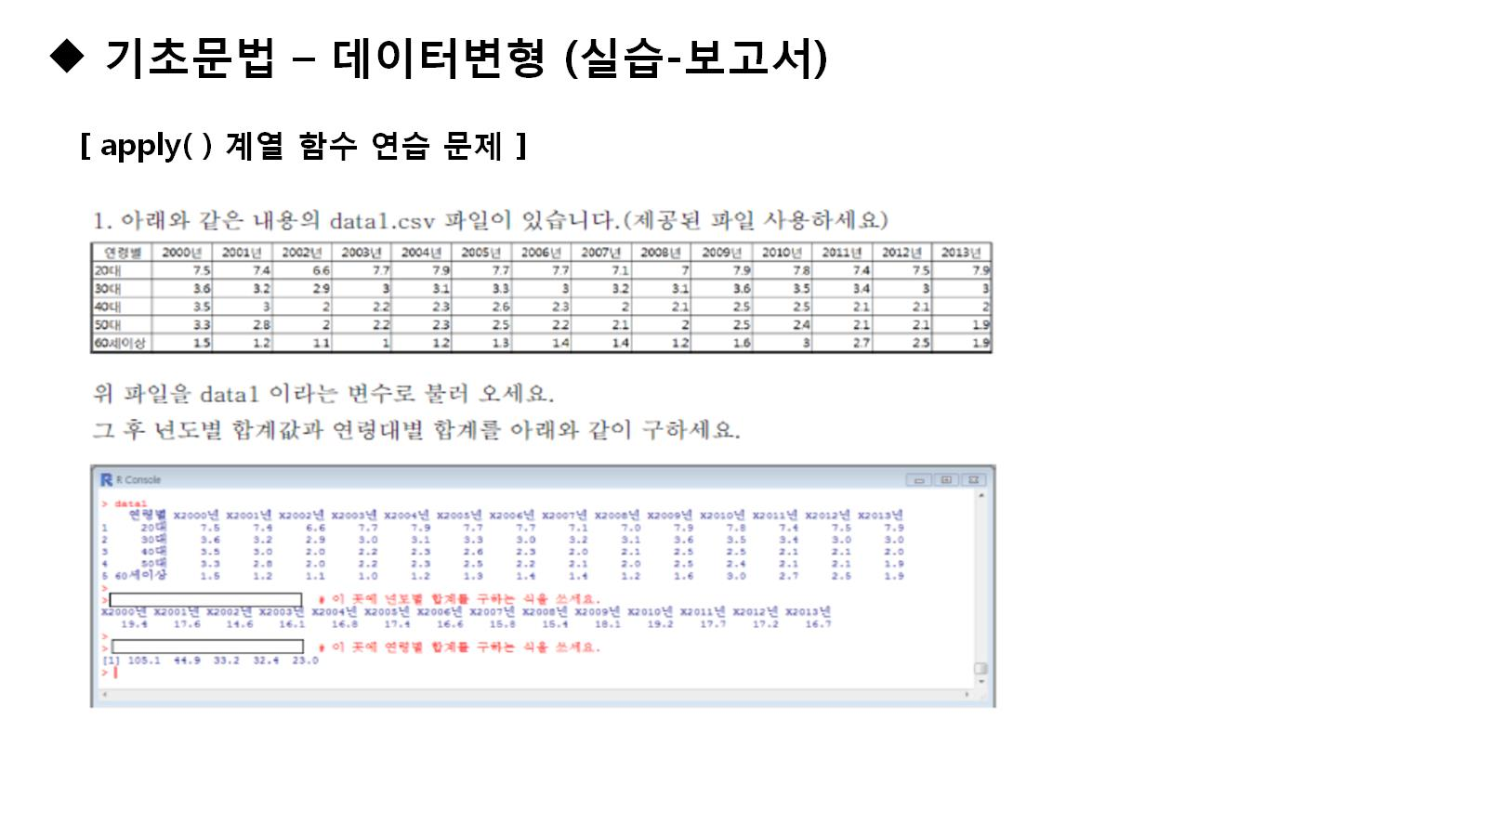

Slide 16
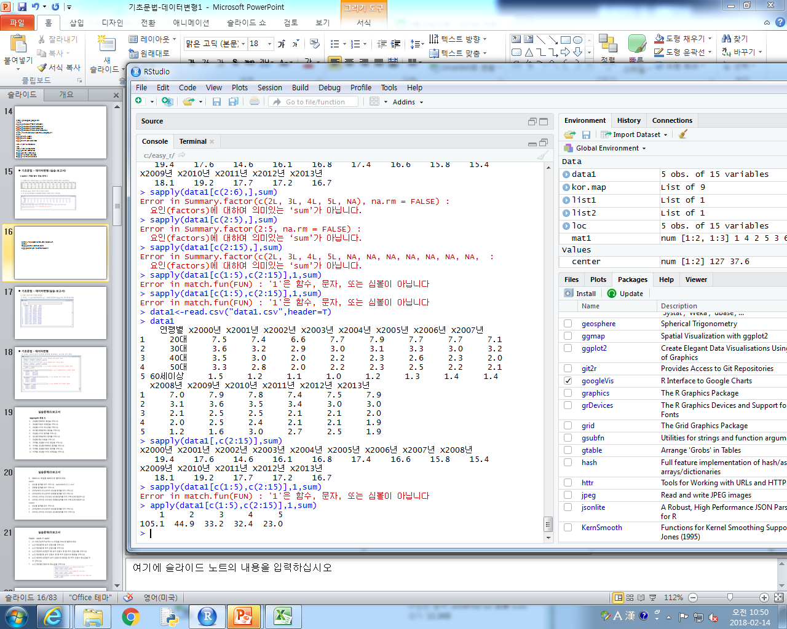
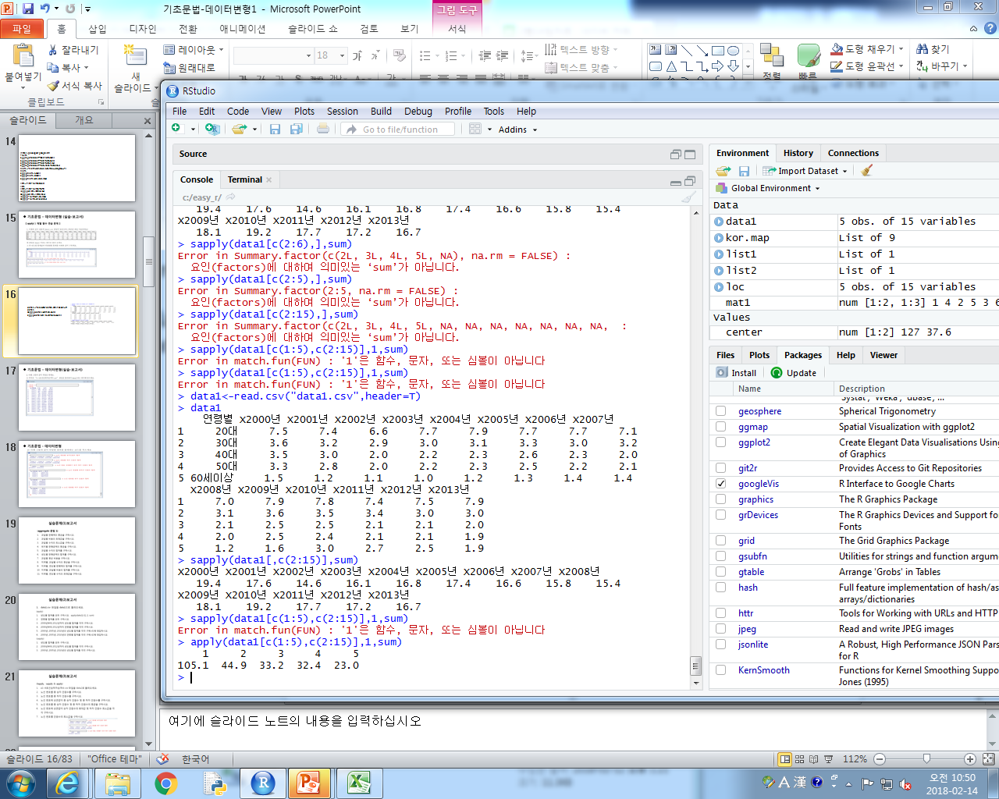
data1<-read.csv("data1.csv",header=T)
data1
sapply(data1[,c(2:15)],sum)
apply(data1[c(1:5),c(2:15)],1,sum)

Slide 17
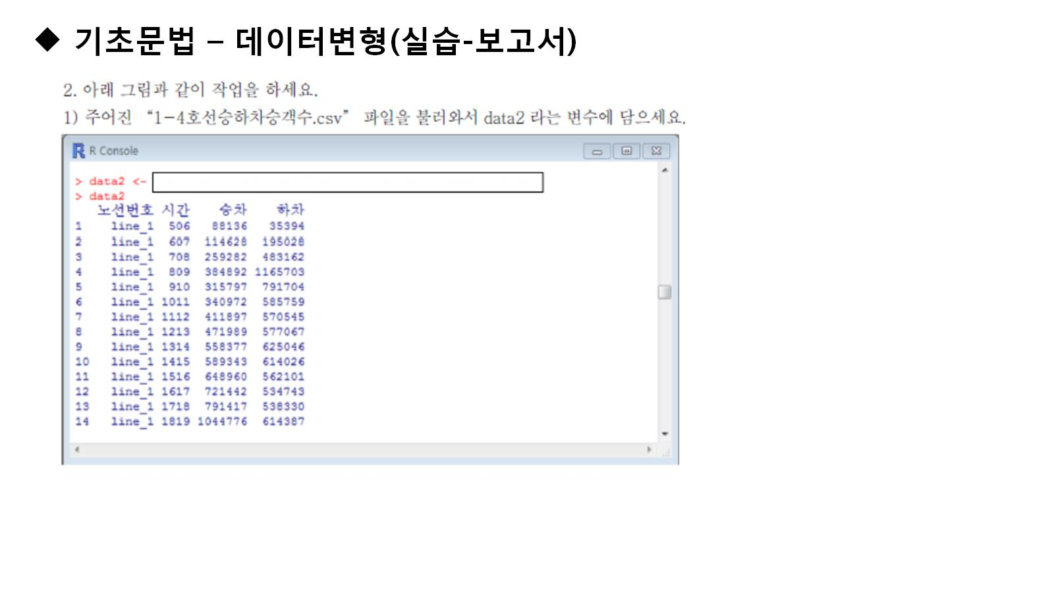

Slide 18
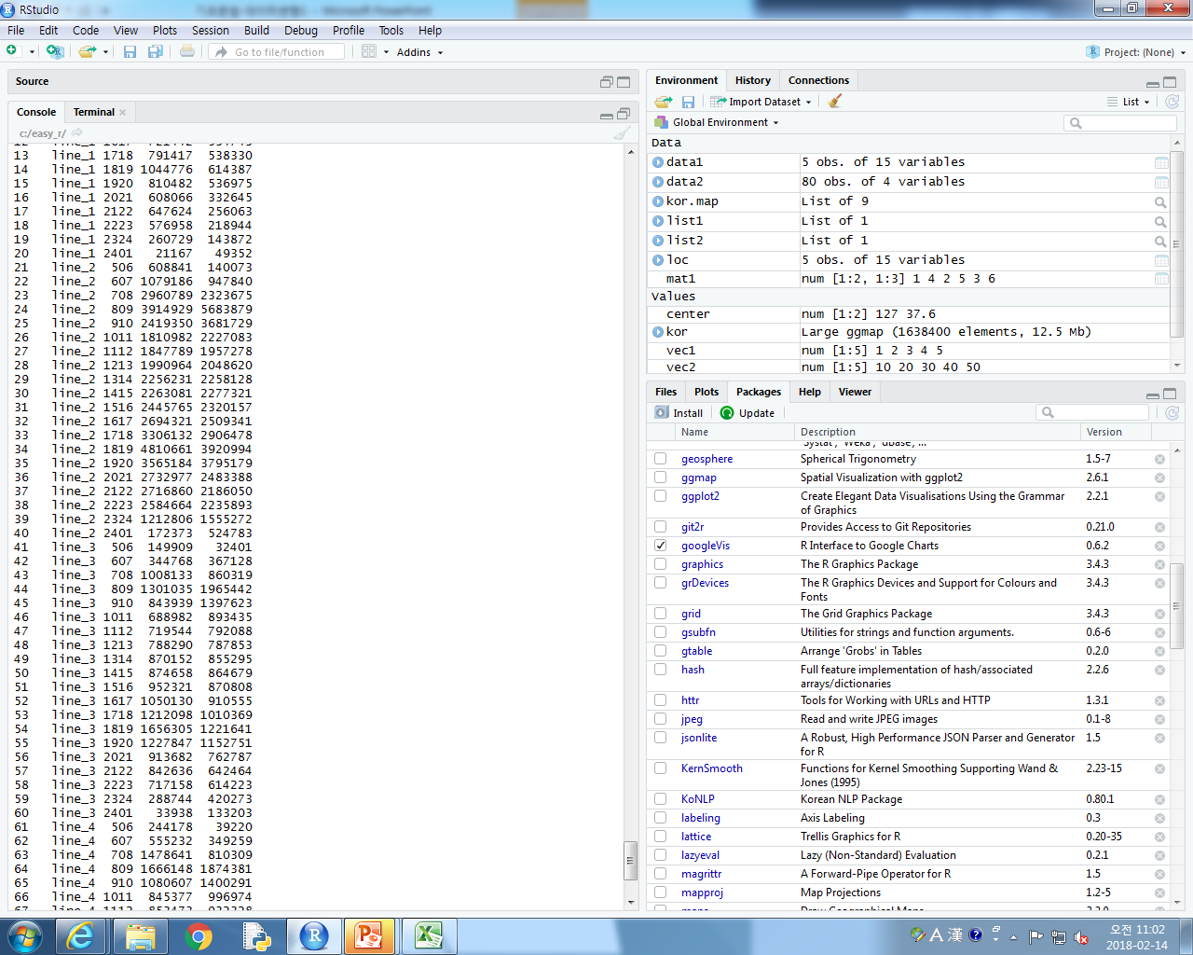
data2<-read.csv("1-4호선승하차승객수.csv",header=T)
data2

Slide 19
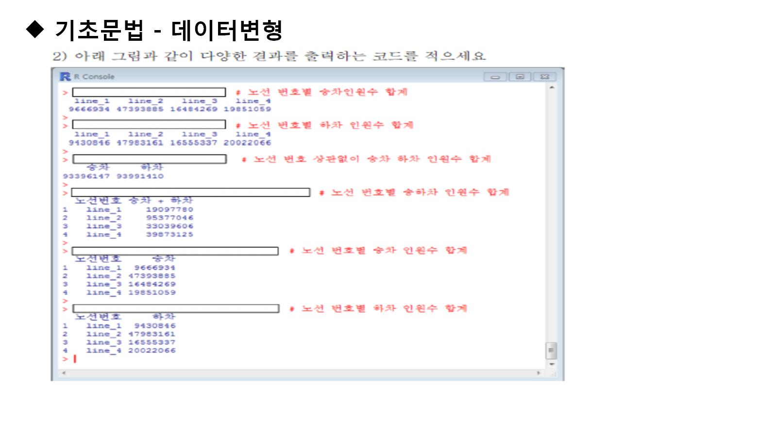

Slide 20
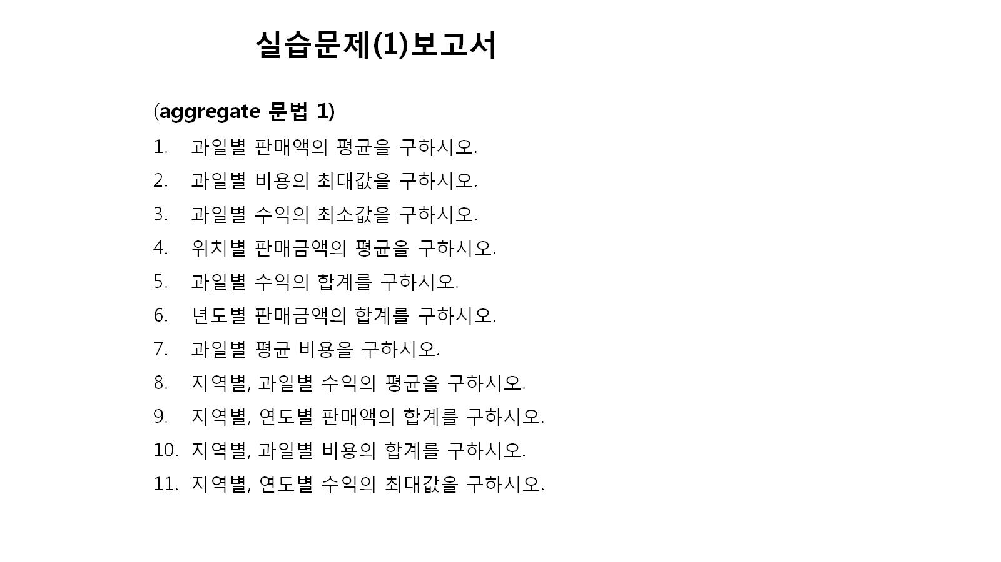

Slide 21
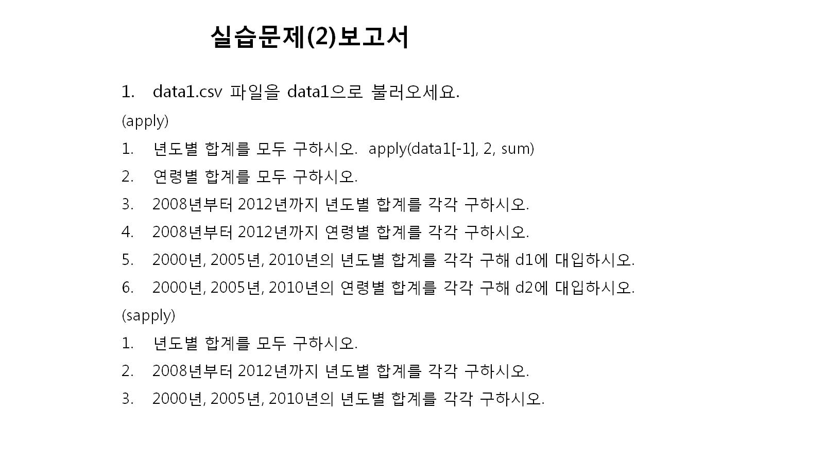

Slide 22
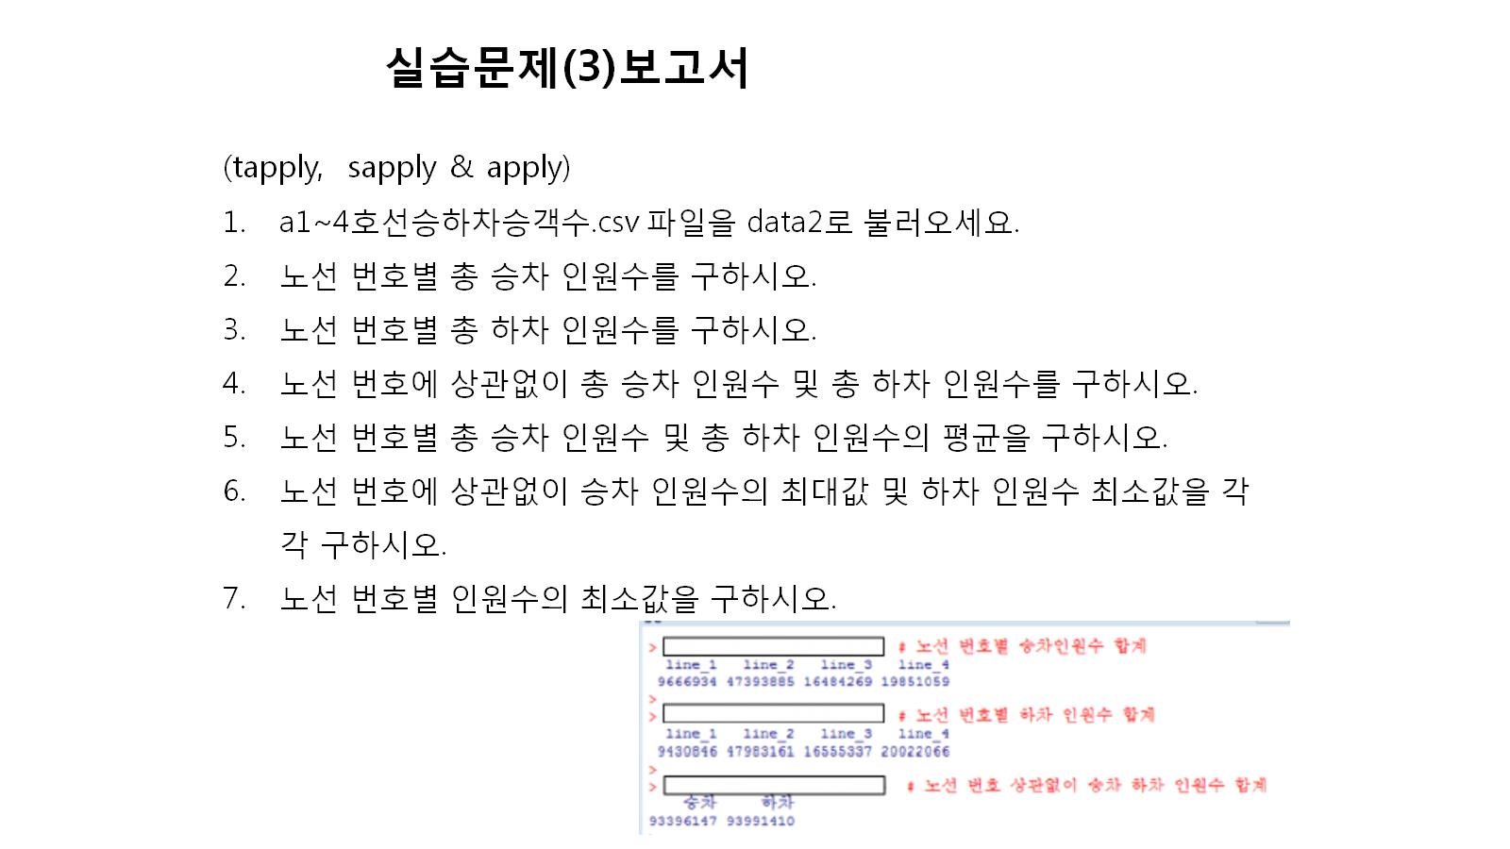

Slide 23
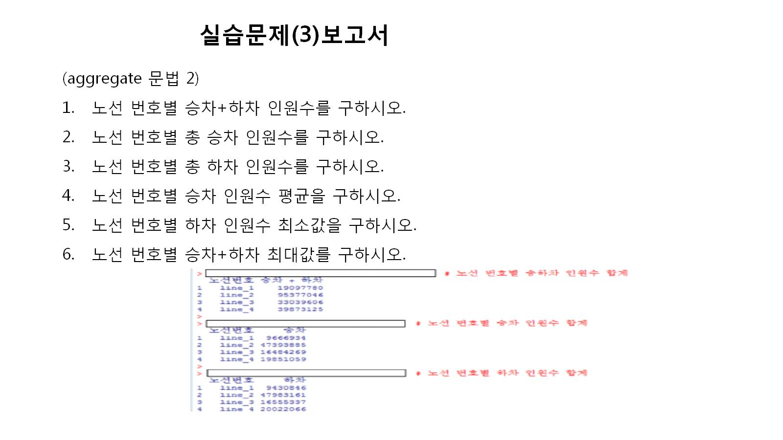

Slide 24
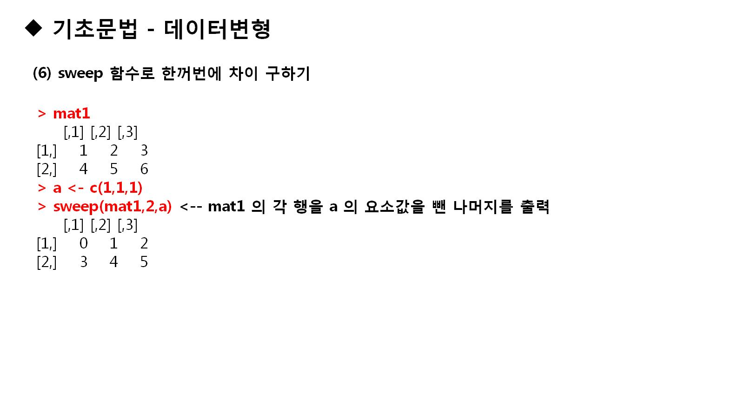

Slide 25
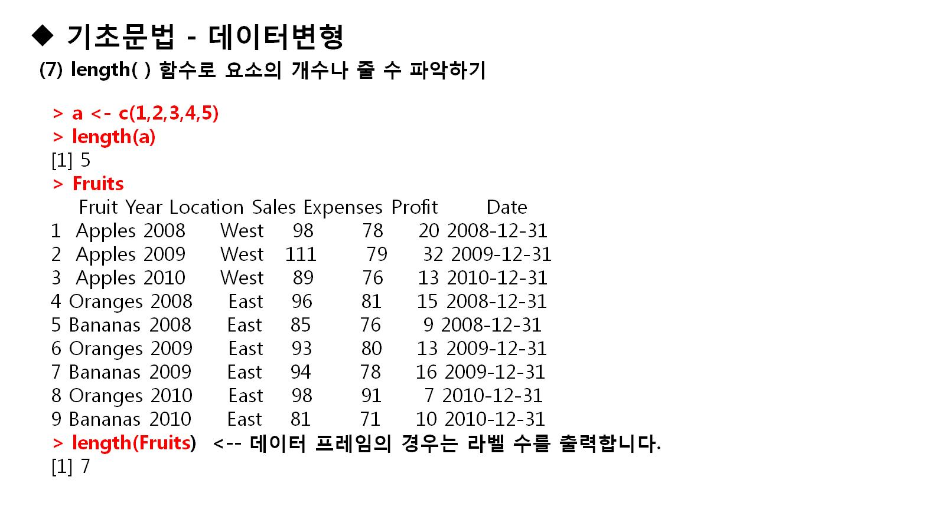

Slide 26


Slide 27
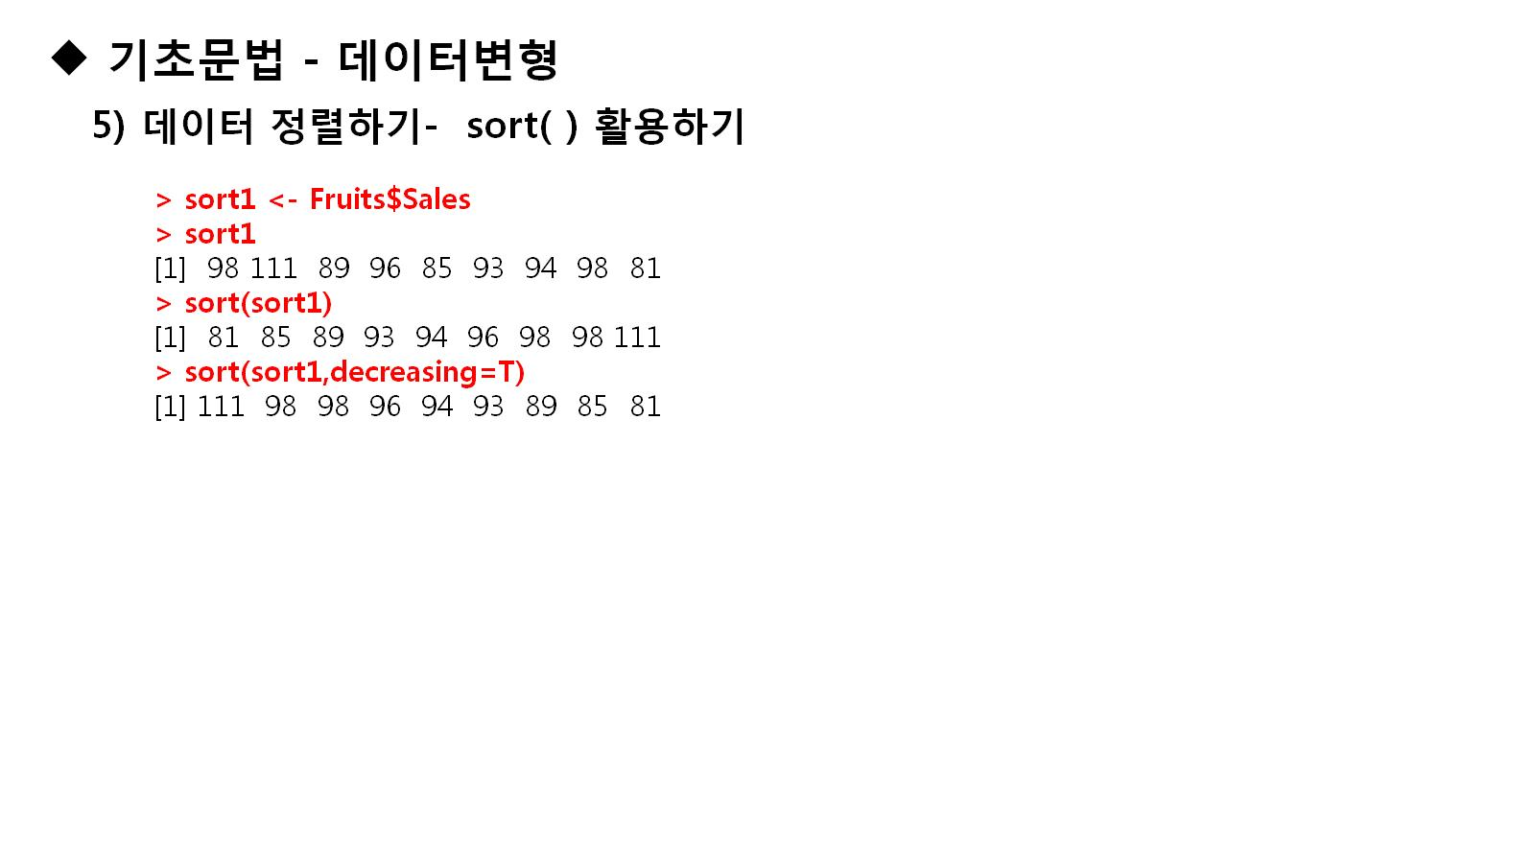

Slide 28
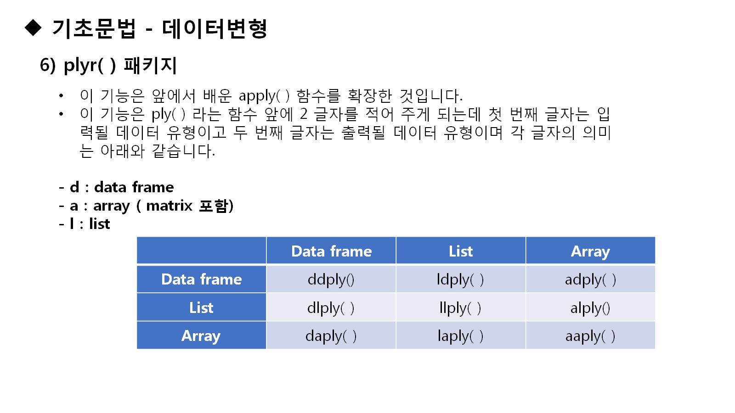

Slide 29
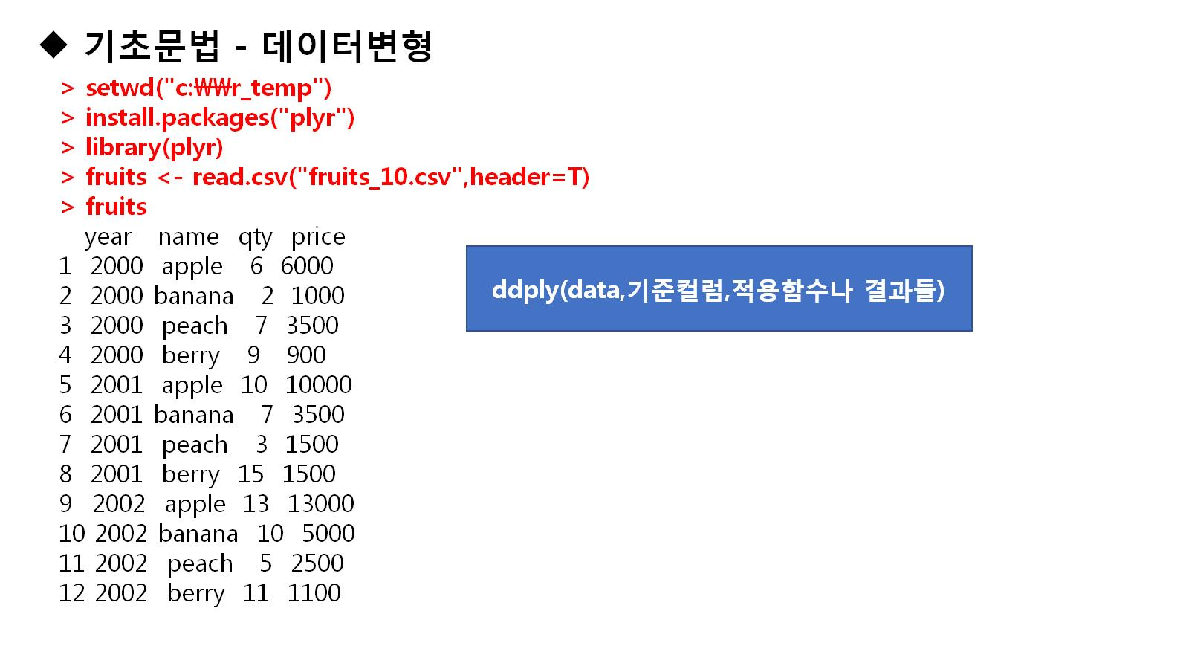
Notes:
setwd("c:\\easy_r")
install.packages("plyr")
library(plyr)
fruits<-read.csv("fruits_10.csv",header=T)
fruits

Slide 30
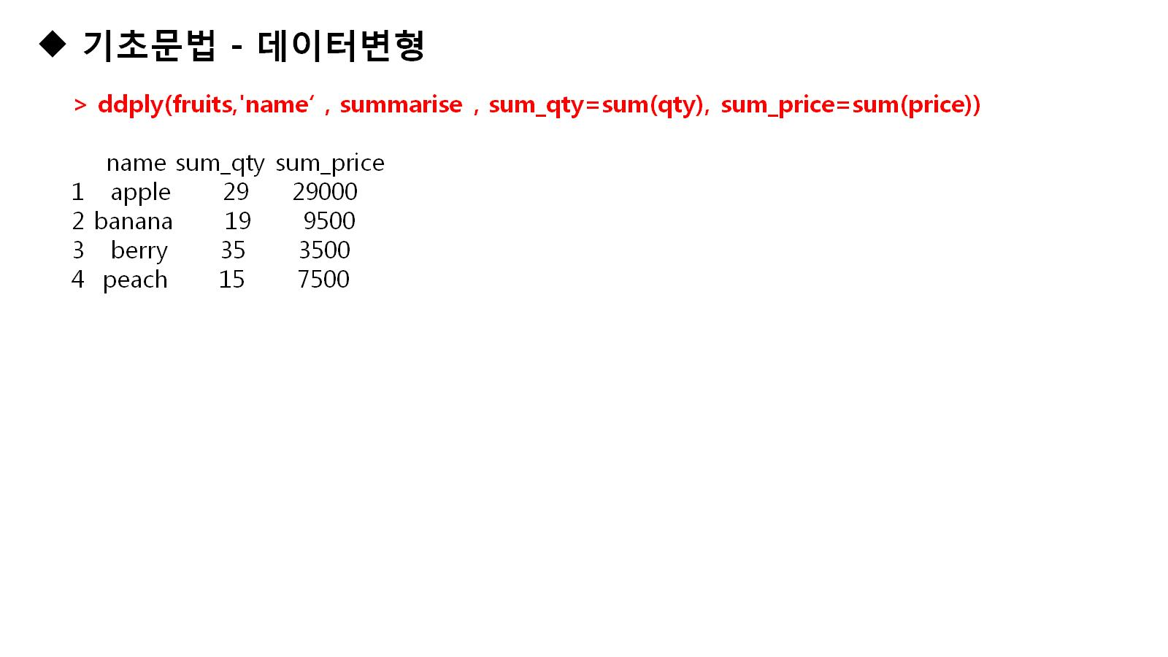

Slide 31
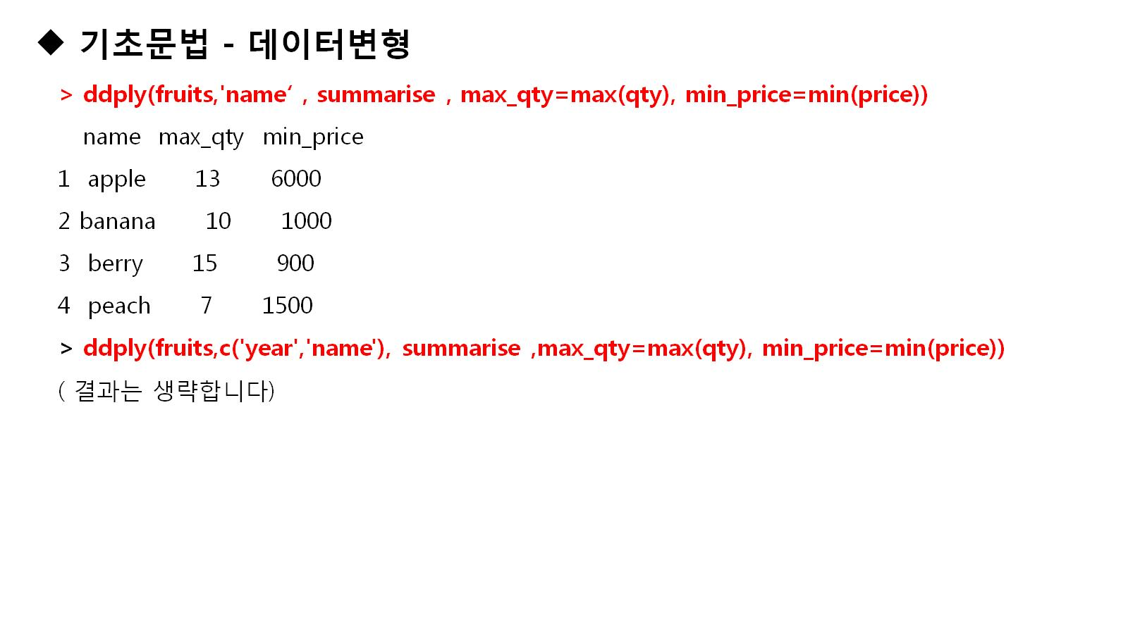
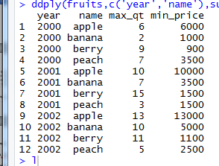
Notes:
setwd("c:\\easy_r")
install.packages("plyr")
library(plyr)
fruits<-read.csv("fruits_10.csv",header=T)
fruits
ddply(fruits,'name',summarise,sum_qty=sum(qty),sum_price=sum(price))
ddply(fruits,'name',summarise,max_qty=max(qty),min_price=min(price))
ddply(fruits,c('year','name'),summarise,max_qt=max(qty),min_price=min(price))

Slide 32
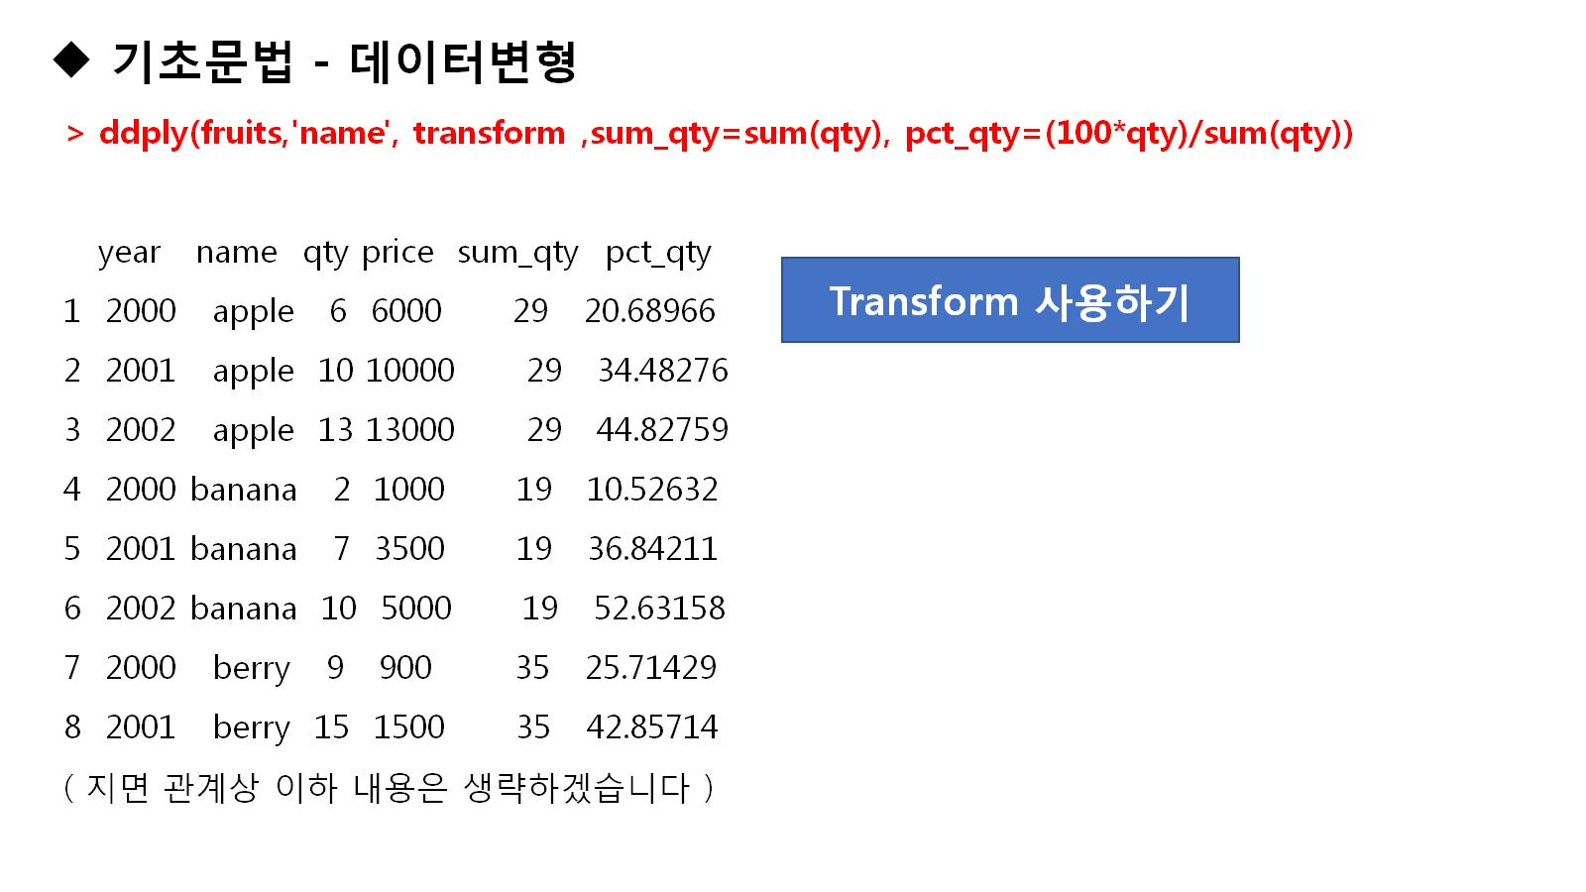

Slide 33
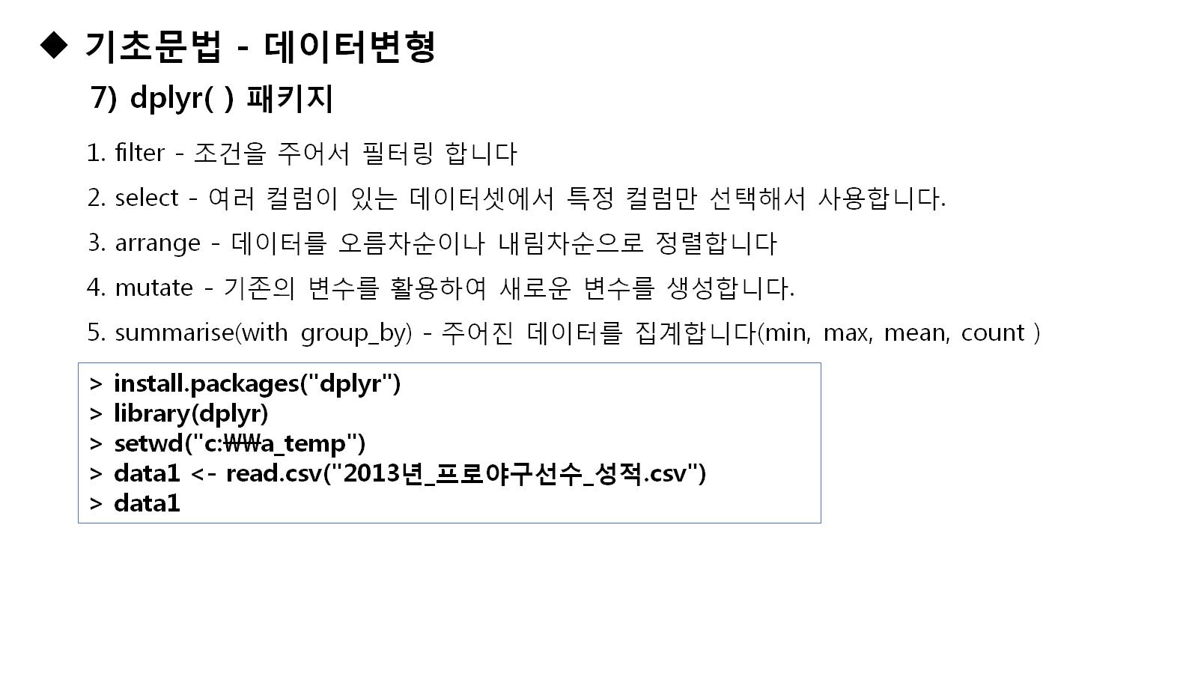

Slide 34
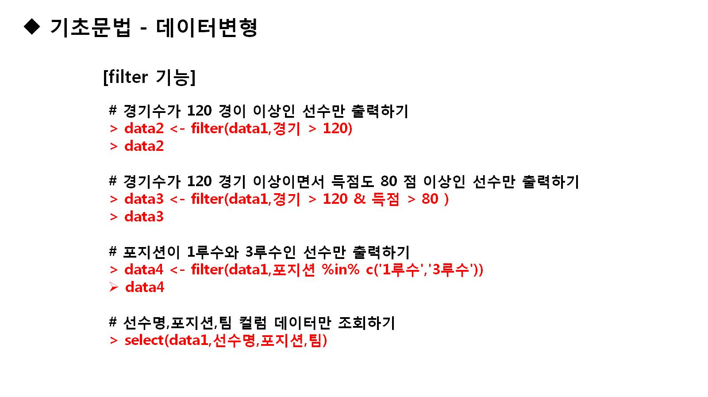

Slide 35
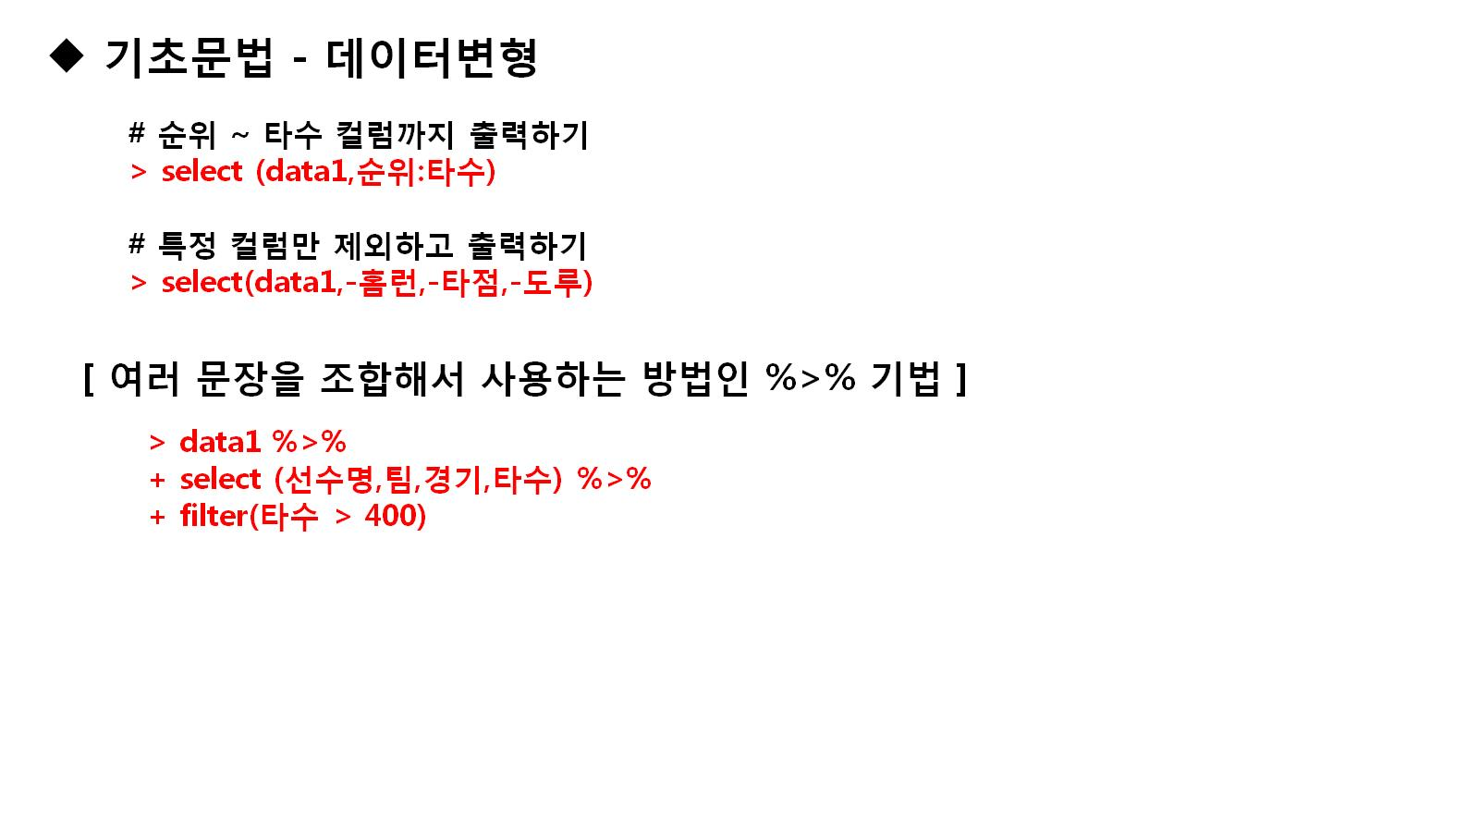

Slide 36
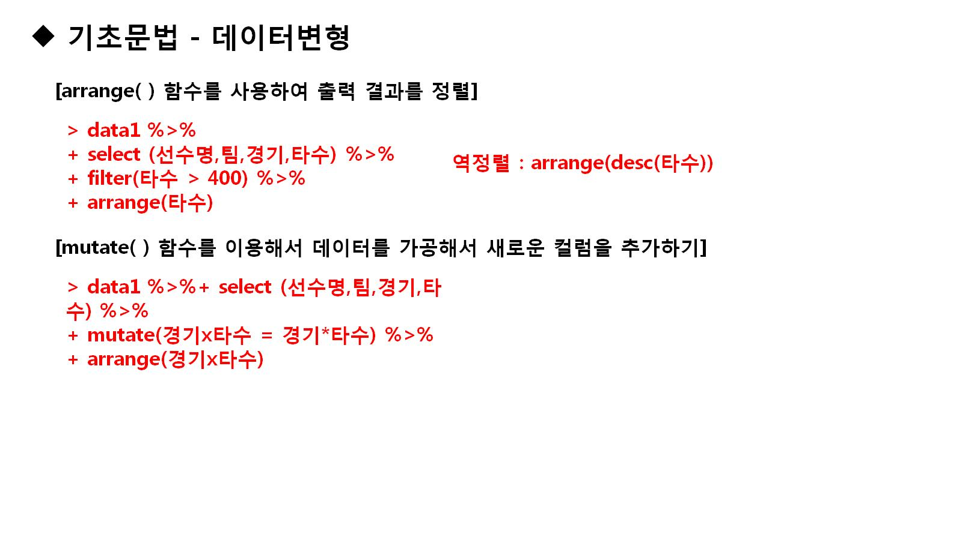

Slide 37
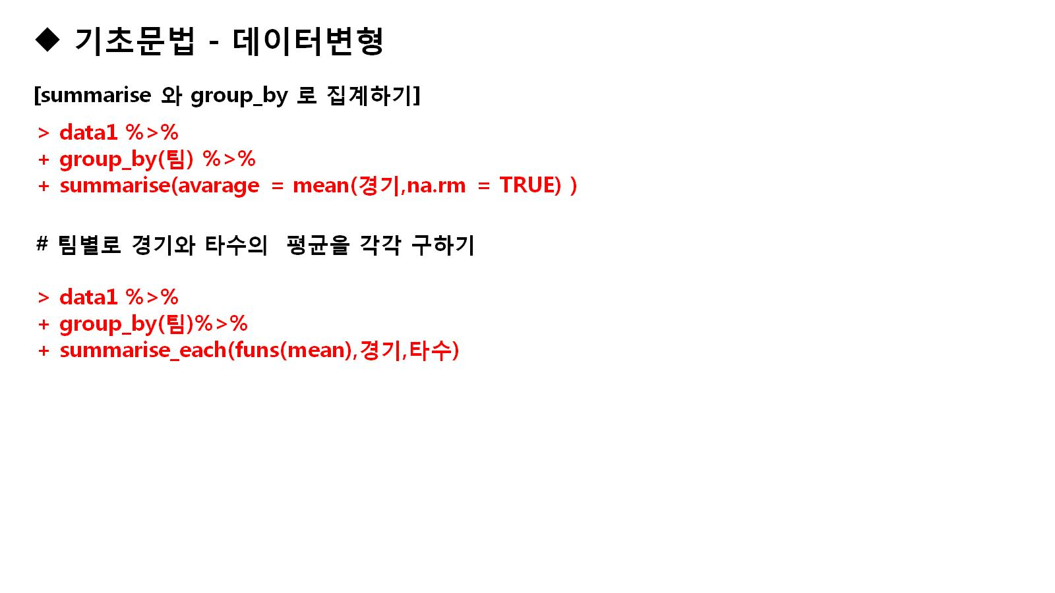

Slide 38
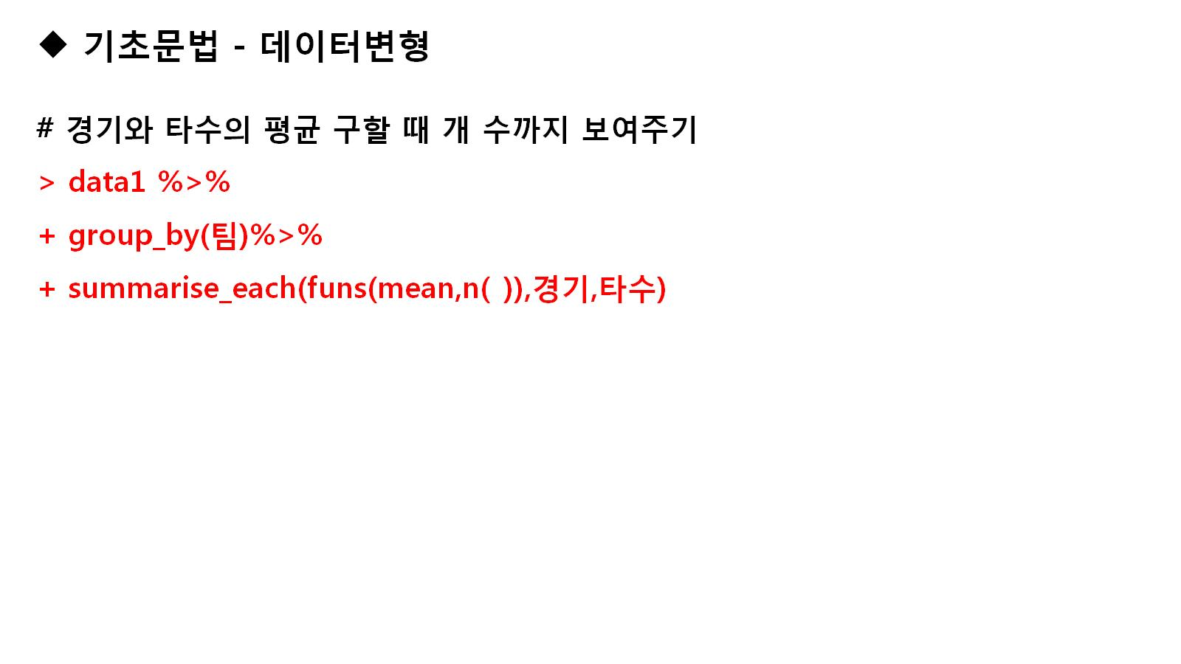

Slide 39


Slide 40
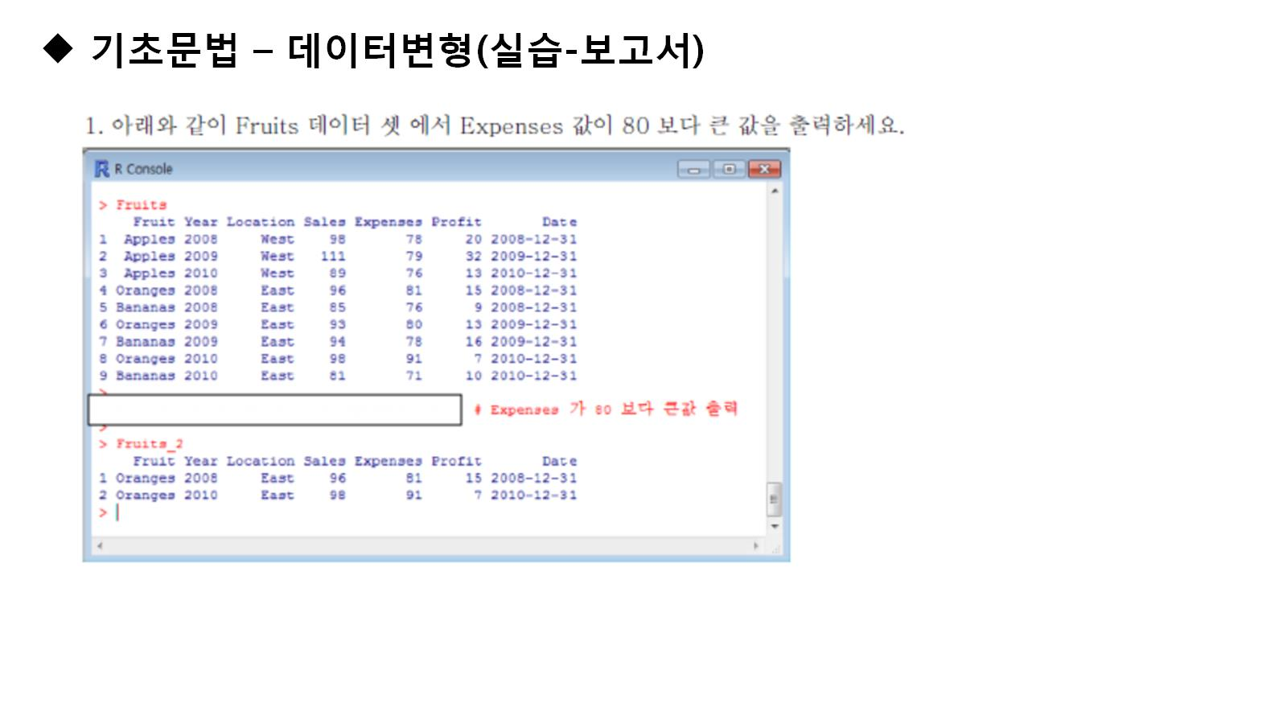

Slide 41
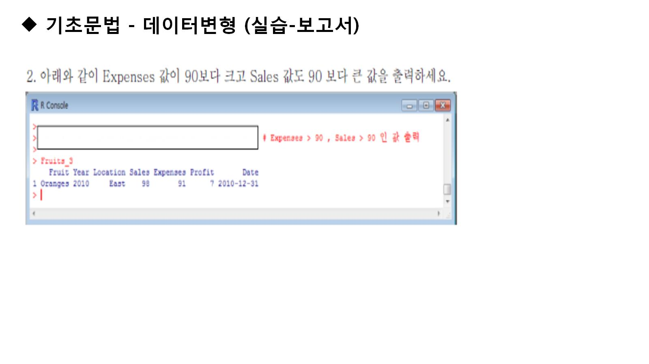

Slide 42
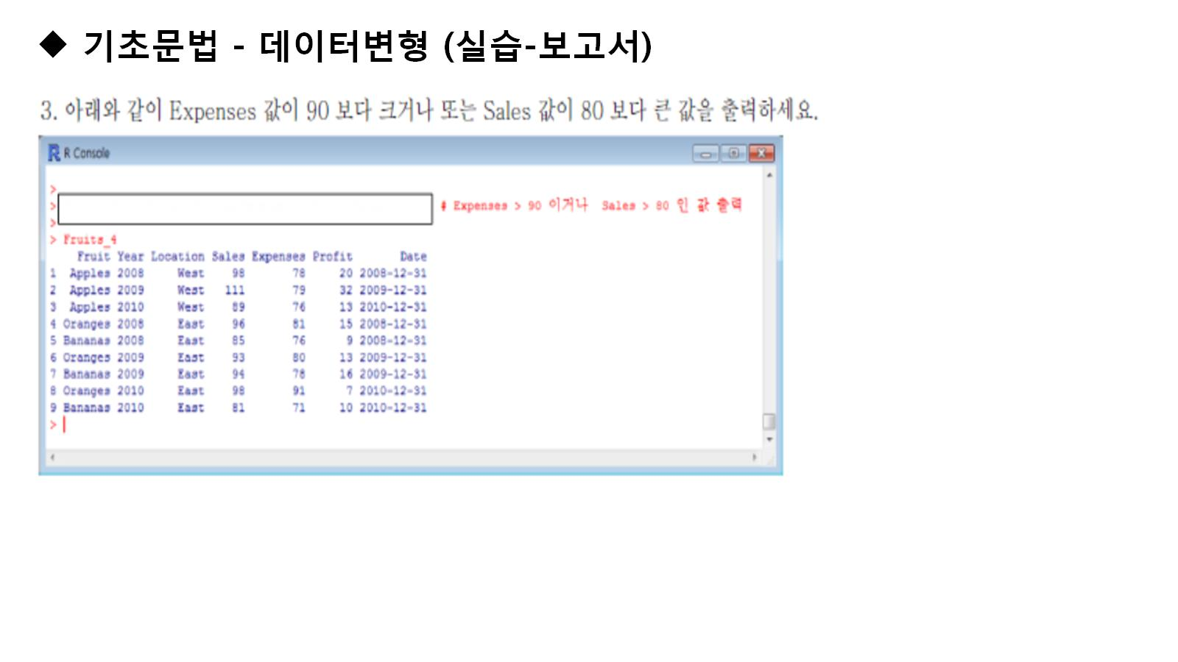

Slide 43
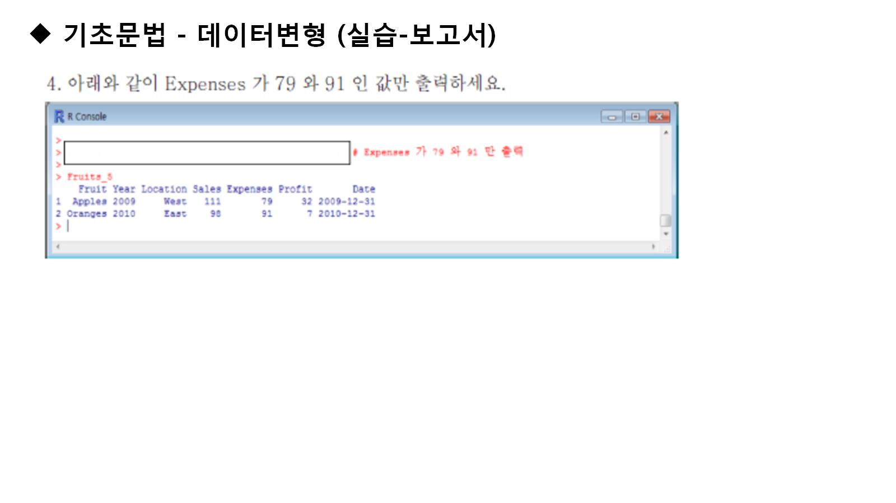

Slide 44
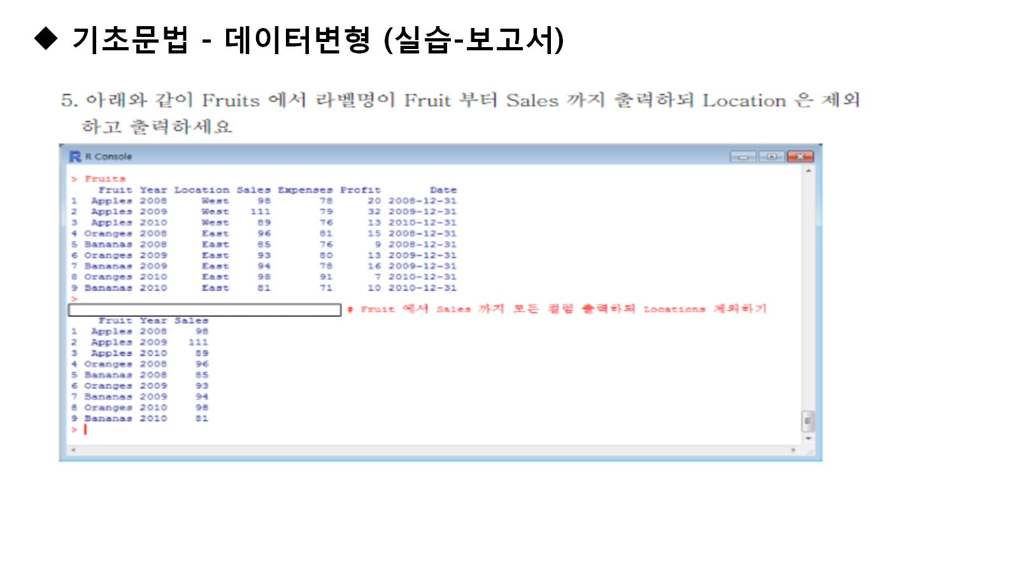

Slide 45
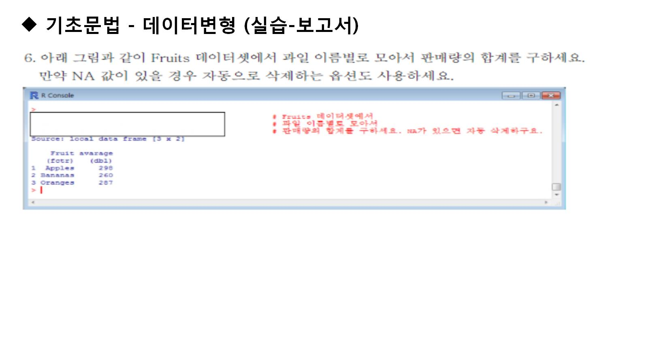

Slide 46
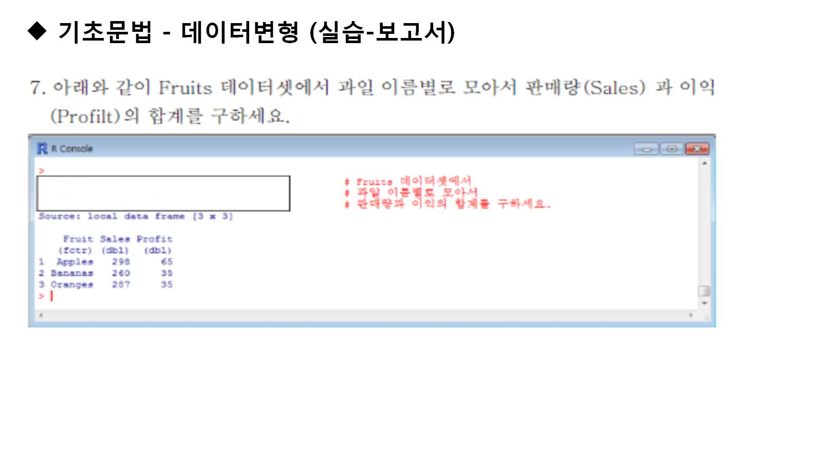

Slide 47
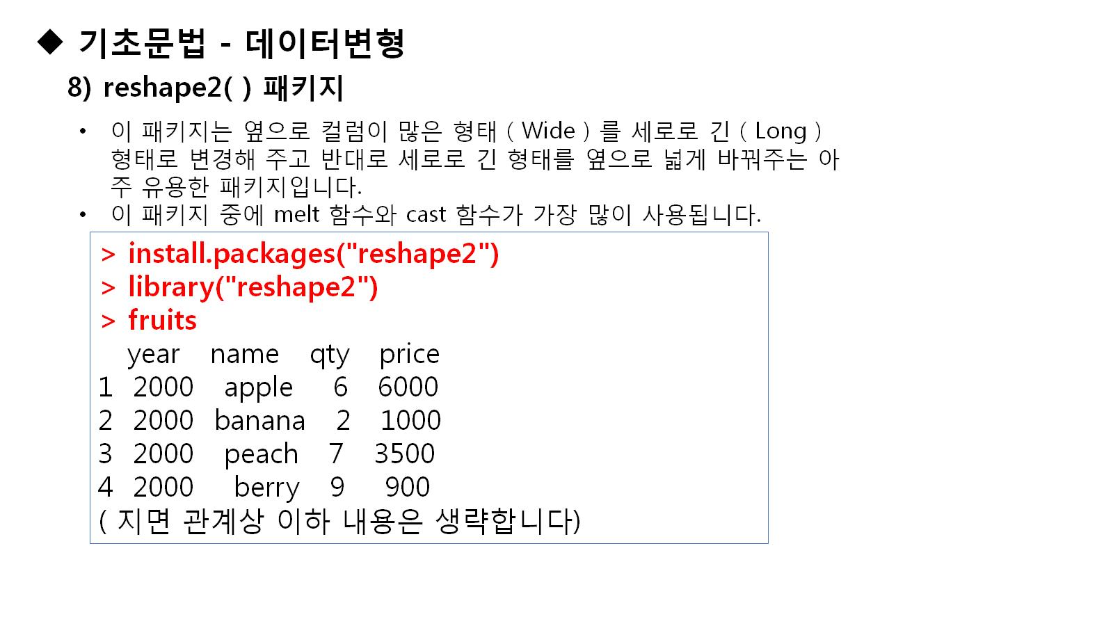

Slide 48
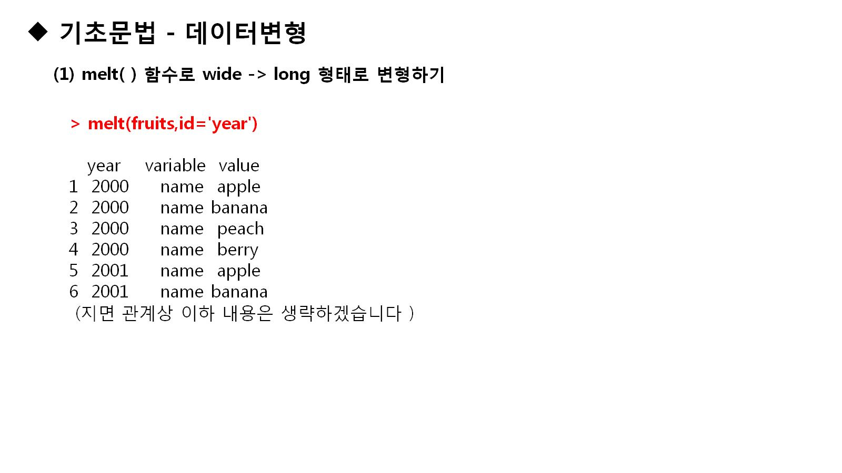
Notes:
melt(fruits,id='year')
melt(fruits,id=c('year',name'))

Slide 49
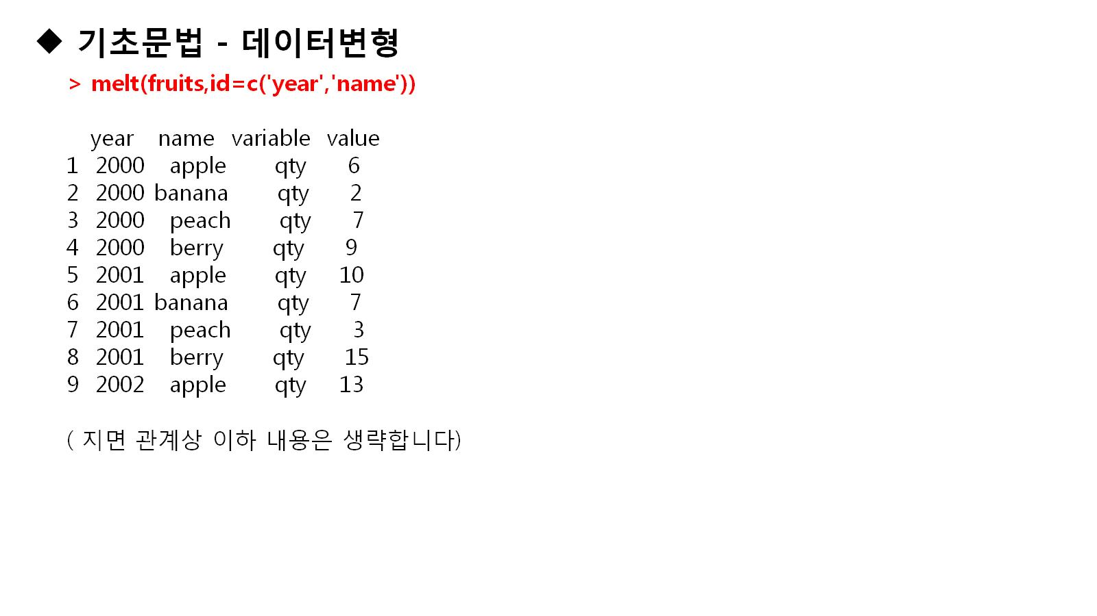

Slide 50
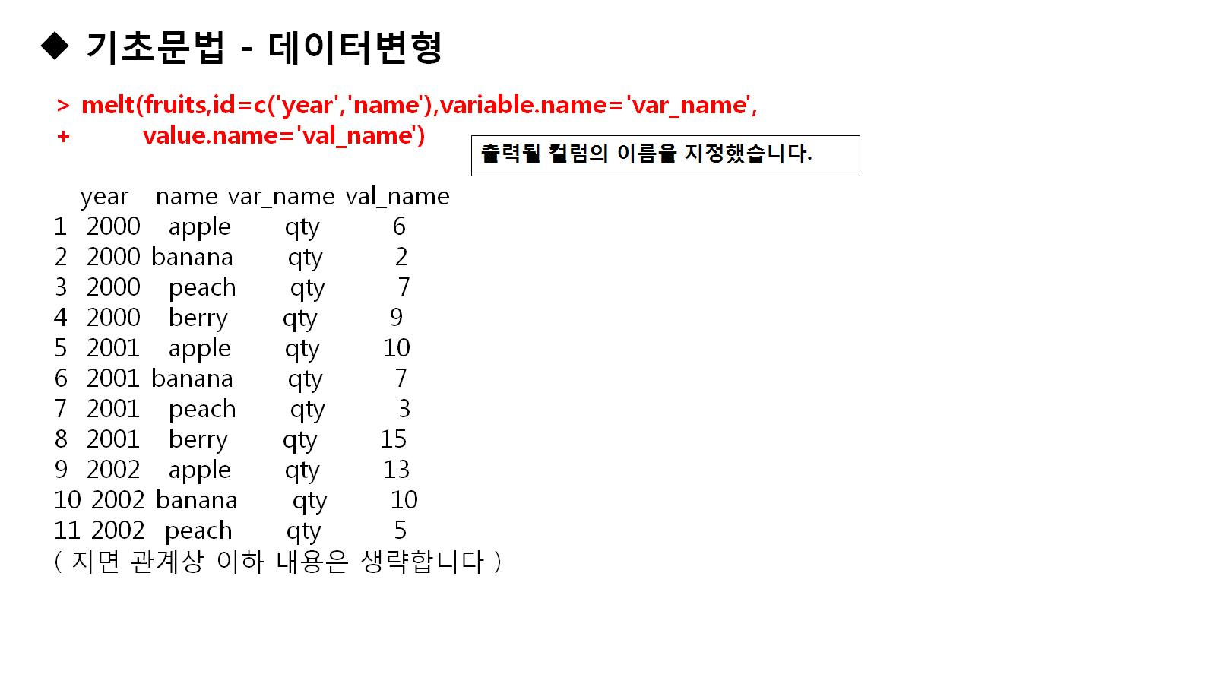

Slide 51
install.packages("reshape2")
fruits
melt(fruits,id='year')
melt(fruits,id=c('year','name'))
melt(fruits,id=c('year','name'),variable.name='var_name',value.name = 'val_name')

Slide 52
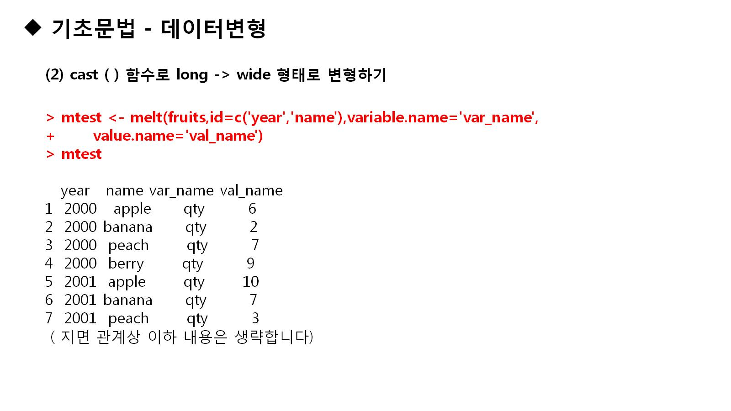

Slide 53
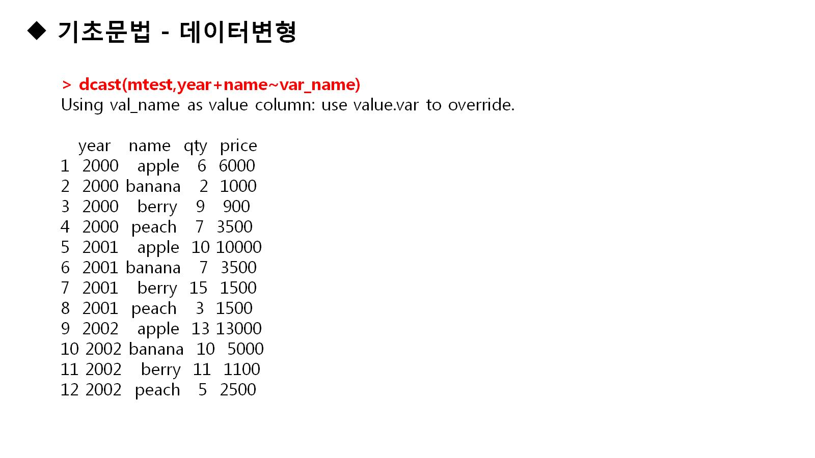

Slide 54
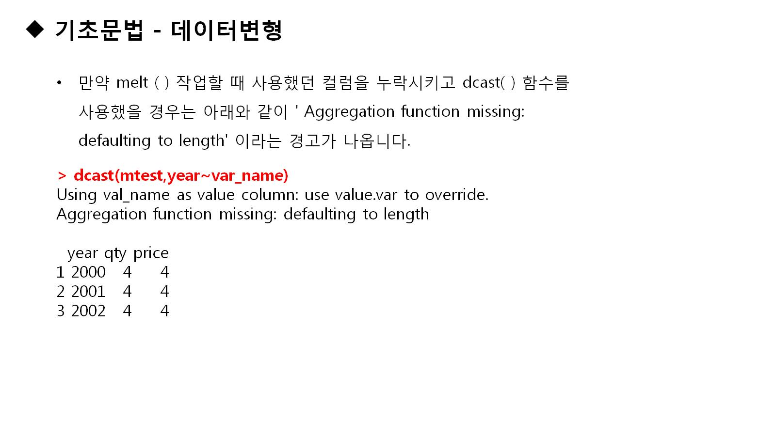

Slide 55
mtest<-melt(fruits,id=c('year','name'),variable.name='var_name',value.name = 'val_name')
mtest
dcast(mtest,year+name~var_name)
dcast(mtest,year~var_name)
dcast(mtest,name~var_name,sum)

Slide 56


Slide 57


Slide 58
install.packages("stringr")
fruits<-c('apple','Apple','banana','pineapple')
str_detect(fruits,'A')
str_detect(fruits,'^a')
str_detect(fruits,'e$')
str_detect(fruits,'^[aA]')
str_detect(fruits,'[aA]')

Slide 59


Slide 60
str_detect(fruits,ignore.case('a'))
fruits
str_count(fruits,ignore.case('a'))
str_count(fruits,'a')

Slide 61

Notes:
str_c("apple","banana")
str_c(fruits,collapse = "")
str_c(fruits,collapse = "-")

Slide 62


Slide 63


Slide 64


Slide 65

Notes:
str_sub(fruits,start=1,end=3)
str_sub(fruits,start=6,end=9)

Slide 66


Slide 67


Slide 68


Slide 69


Slide 70


Slide 71


Slide 72


Slide 73


Slide 74


Slide 75

Notes:
str_sub(fruits,start=1,end=3)
str_sub(fruits,start=6,end=9)

Slide 76


Slide 77


Slide 78


Slide 79


Slide 80


Slide 81


Slide 82


Slide 83


Slide 84


Slide 85


Slide 86


Slide 87


Slide 88


